Slide 1
Literature in Frames: Storyboarding Pivotal Moments of Short Stories
By Mia Green

Slide 2
What did I study? Why is it important?
Connections between art and literature
Use of storyboards in classrooms
Theories surrounding plot structure
Enables a reader to demonstrate understanding
Provides a creative approach to literary analysis

Slide 3
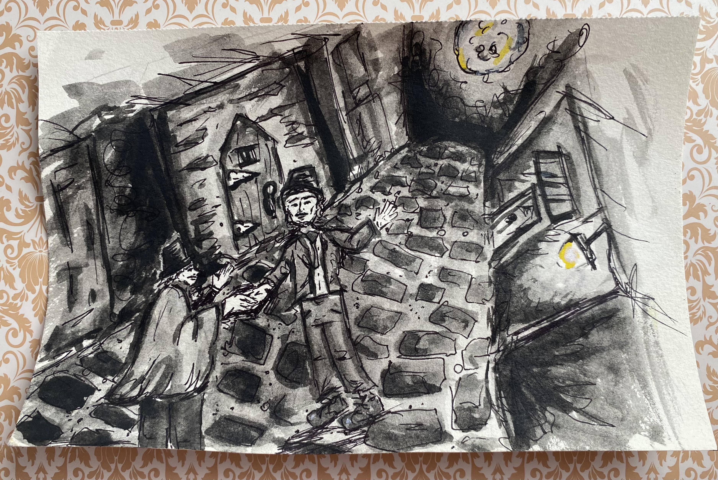
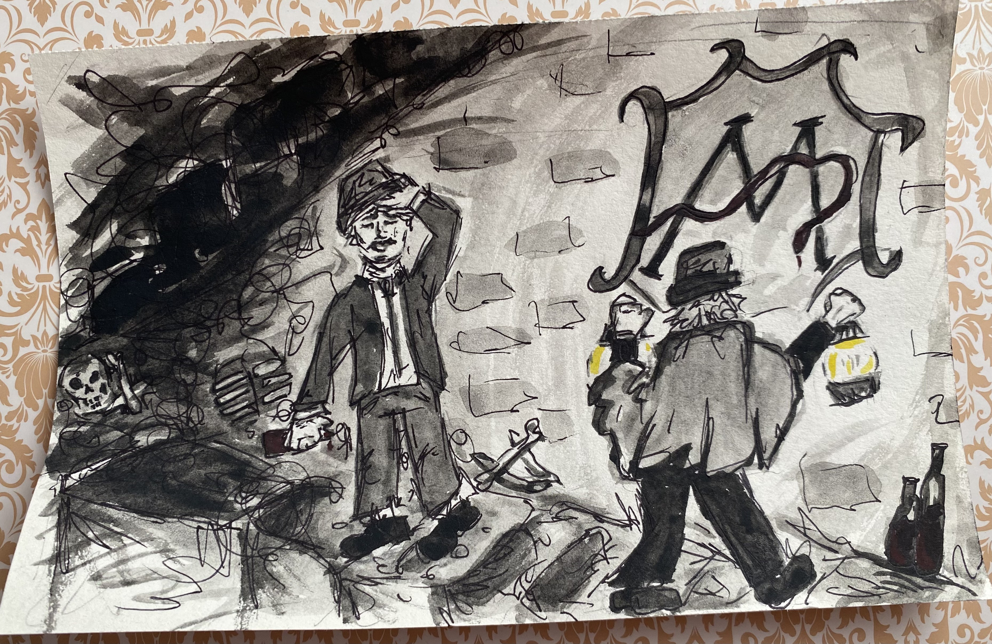
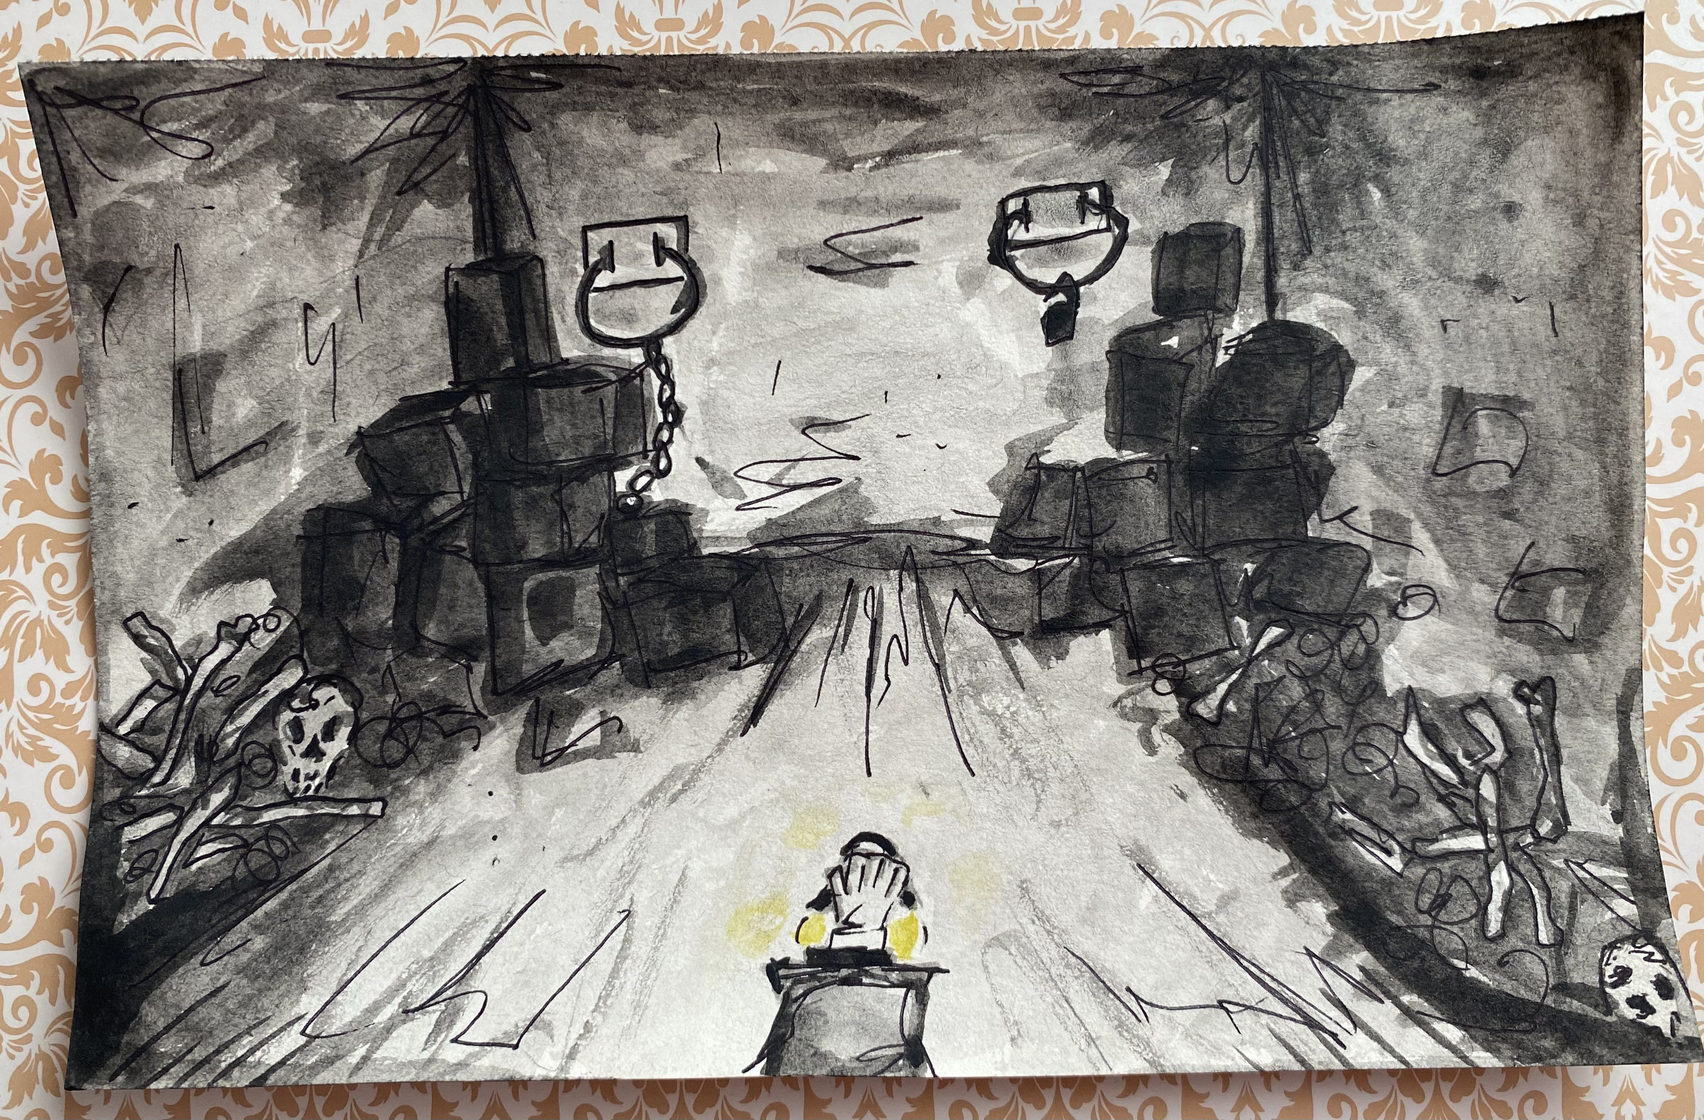
Impetus: “ The Cask of Amontillado” by Edgar Allen Poe
Introduction to Fiction with Mrs. Kellie Thomas
Key scenes of the short story
Understanding of the story

Slide 4
“Storyboards are a means to graphically represent layout, organization, content, and linkages of information to create a conceptual idea of the information, location, meaning, and appearance.”
(Varvel and Lindeman)

Slide 5
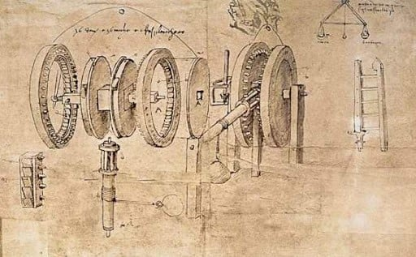
How did storyboarding get its start?
Storyboards were used by Leonardo DaVinci to study his unfinished works.
Storyboards got their start by Webb Smith in the 1930s at Walt Disney Studios.
Webb Smith, "Three Little Pigs"
Leonardo Da Vinci, Engineer Sketch

Slide 6
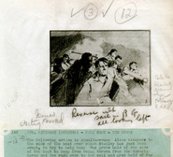
Evolution of Storyboards
Hayao Miyazaki, Spirited Away
Storyboards have evolved since the 1930s and have been used by cinematographers, writers, web developers, designers, and directors such as Alfred Hitchcock and Hayao Miyazaki.
Alfred Hitchcock, Lifeboat

Slide 7
Storyboards in education

Slide 8
Research of Use in Classrooms
“[Students] In writing their storyboards, they became more astute readers of visual texts.”
“A visual record of their (students') learning.”
Activity with The Giver by Lois Lowry
Student use of music to set the tone for scenes

Slide 9
Importance of Learning Styles
“Incorporating a variety of teaching methods that cater to different learning styles can enhance comprehension, retention, and engagement.”
1.Interpersonal
2. Bodily/Kinesthetic & Visual/Spatial
Aspects of preferred learning styles are exercised in creating storyboards.
Ex. The activity done before with The Giver.

Slide 10
Literary Analysis and Plot Lines

Slide 11
Art and Literature
“Arts (are) described as languages through which we express and discover meanings that are otherwise unavailable.” ( Alan Simpson, Language, Literature, and Art)

Slide 12
Storyboarding and Literary Analysis
Storyboards are used as a tool for learning and literary analysis.
Storyboards can frame the plot and show key scenes.
Storyboards are used by readers to create a visual of a story by emphasizing authors' descriptions, style, and overarching themes.
Storyboard creation can help with understanding plot structure. (ex. Freytag’s Pyramid)

Slide 13
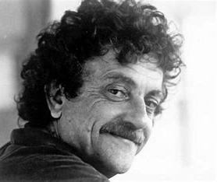
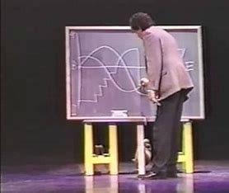
Kurt Vonnegut’s “8 Shapes of Stories”
Vonnegut wrote The Slaughterhouse Five and Cat’s Cradle.
Vonnegut presented his master's thesis at the University of Chicago.
Vonnegut's thesis was rejected by the University of Chicago because it seemed "simple."

Slide 15
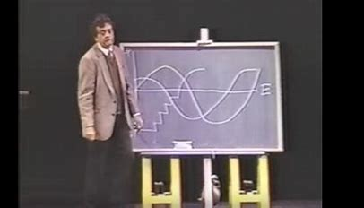

Slide 16
From Bad to Worse
The main character never catches a break.
Authors should always "make awful things happen” to the characters.
Plot Line
The story “Good Country People” by Flannery O’Connor could be said to follow this plot shape.
Ex. Joker (2019)

Slide 17
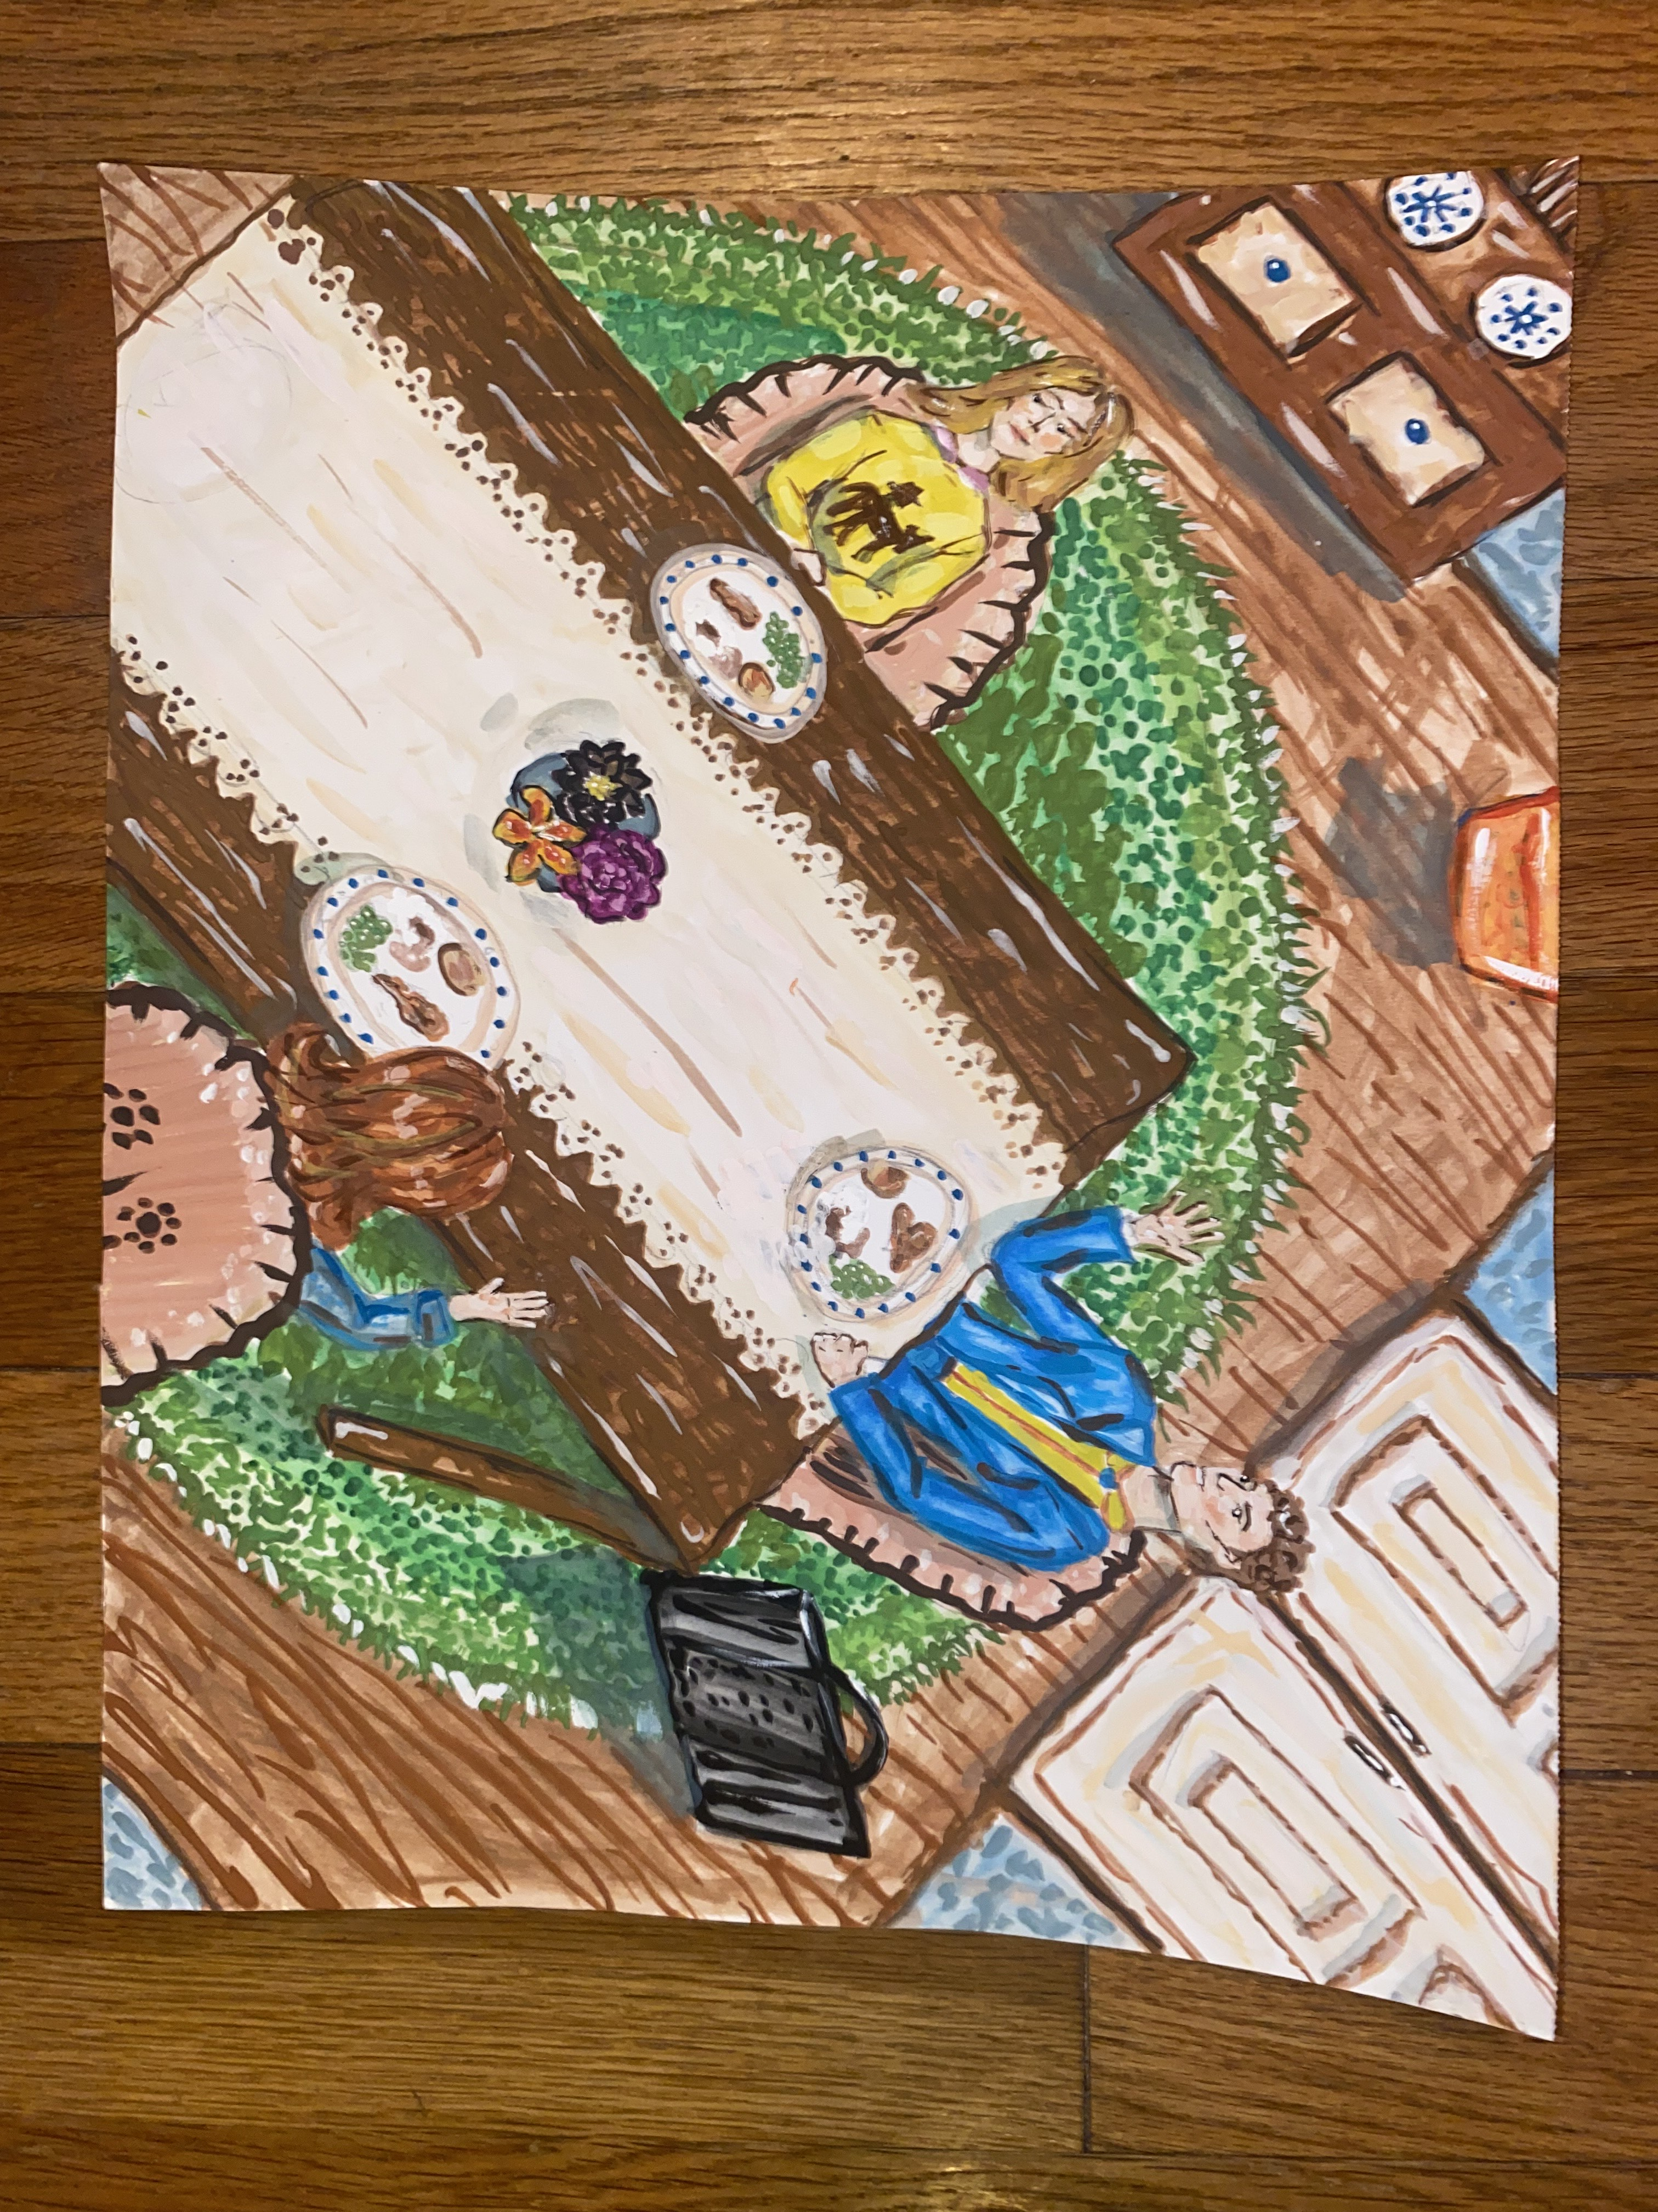
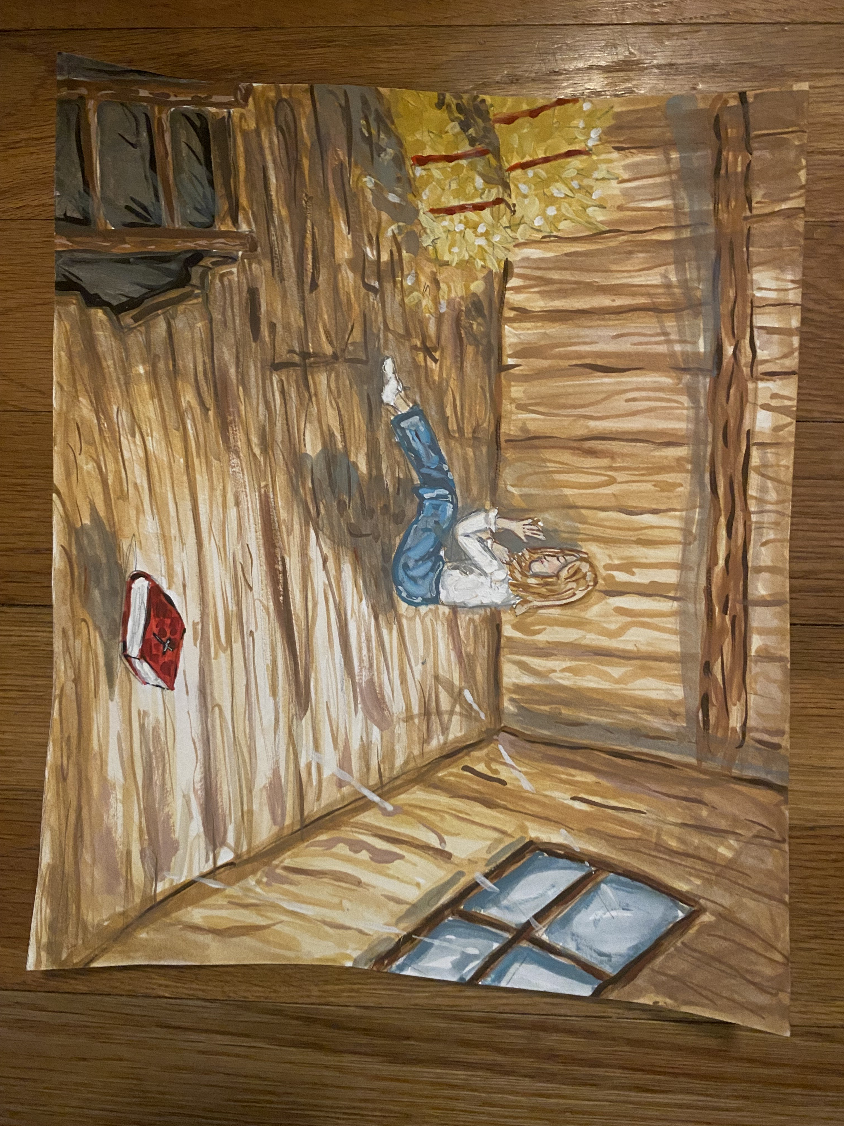
“Good Country People” by Flannery O’Connor

Slide 18
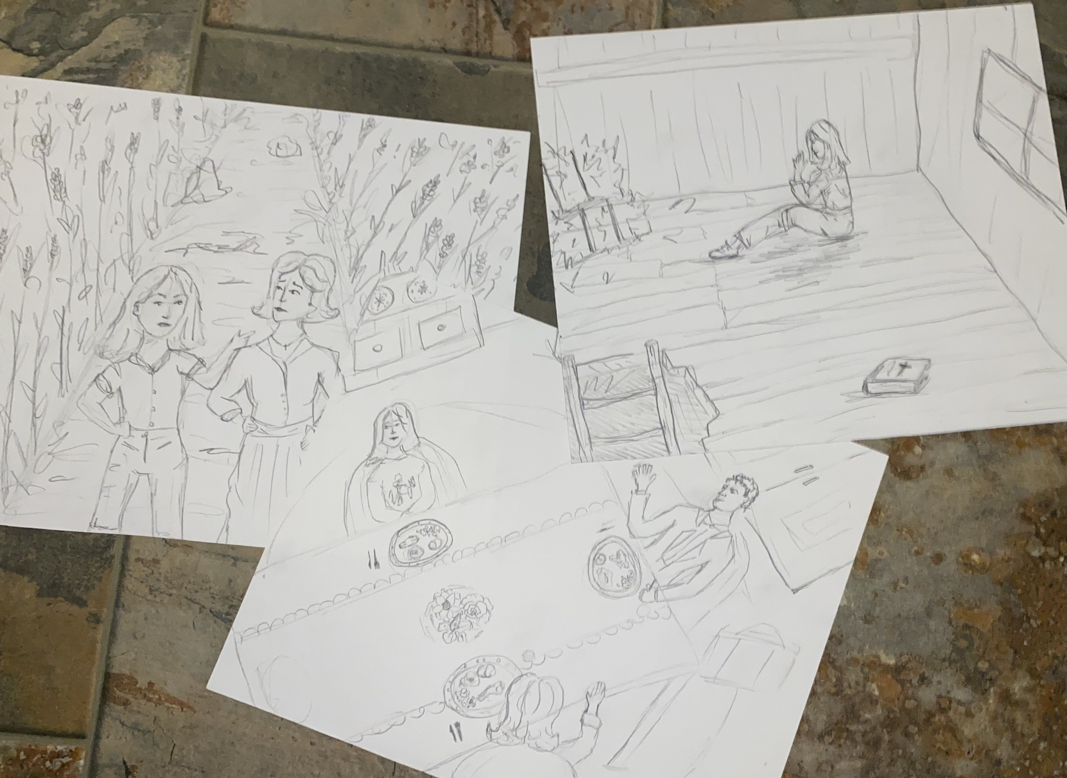
Process of Storyboarding
From Bad to Worse
Scene choices
Characterization

Slide 19
Climax/Resolution
Exposition
Rising Action

Slide 20
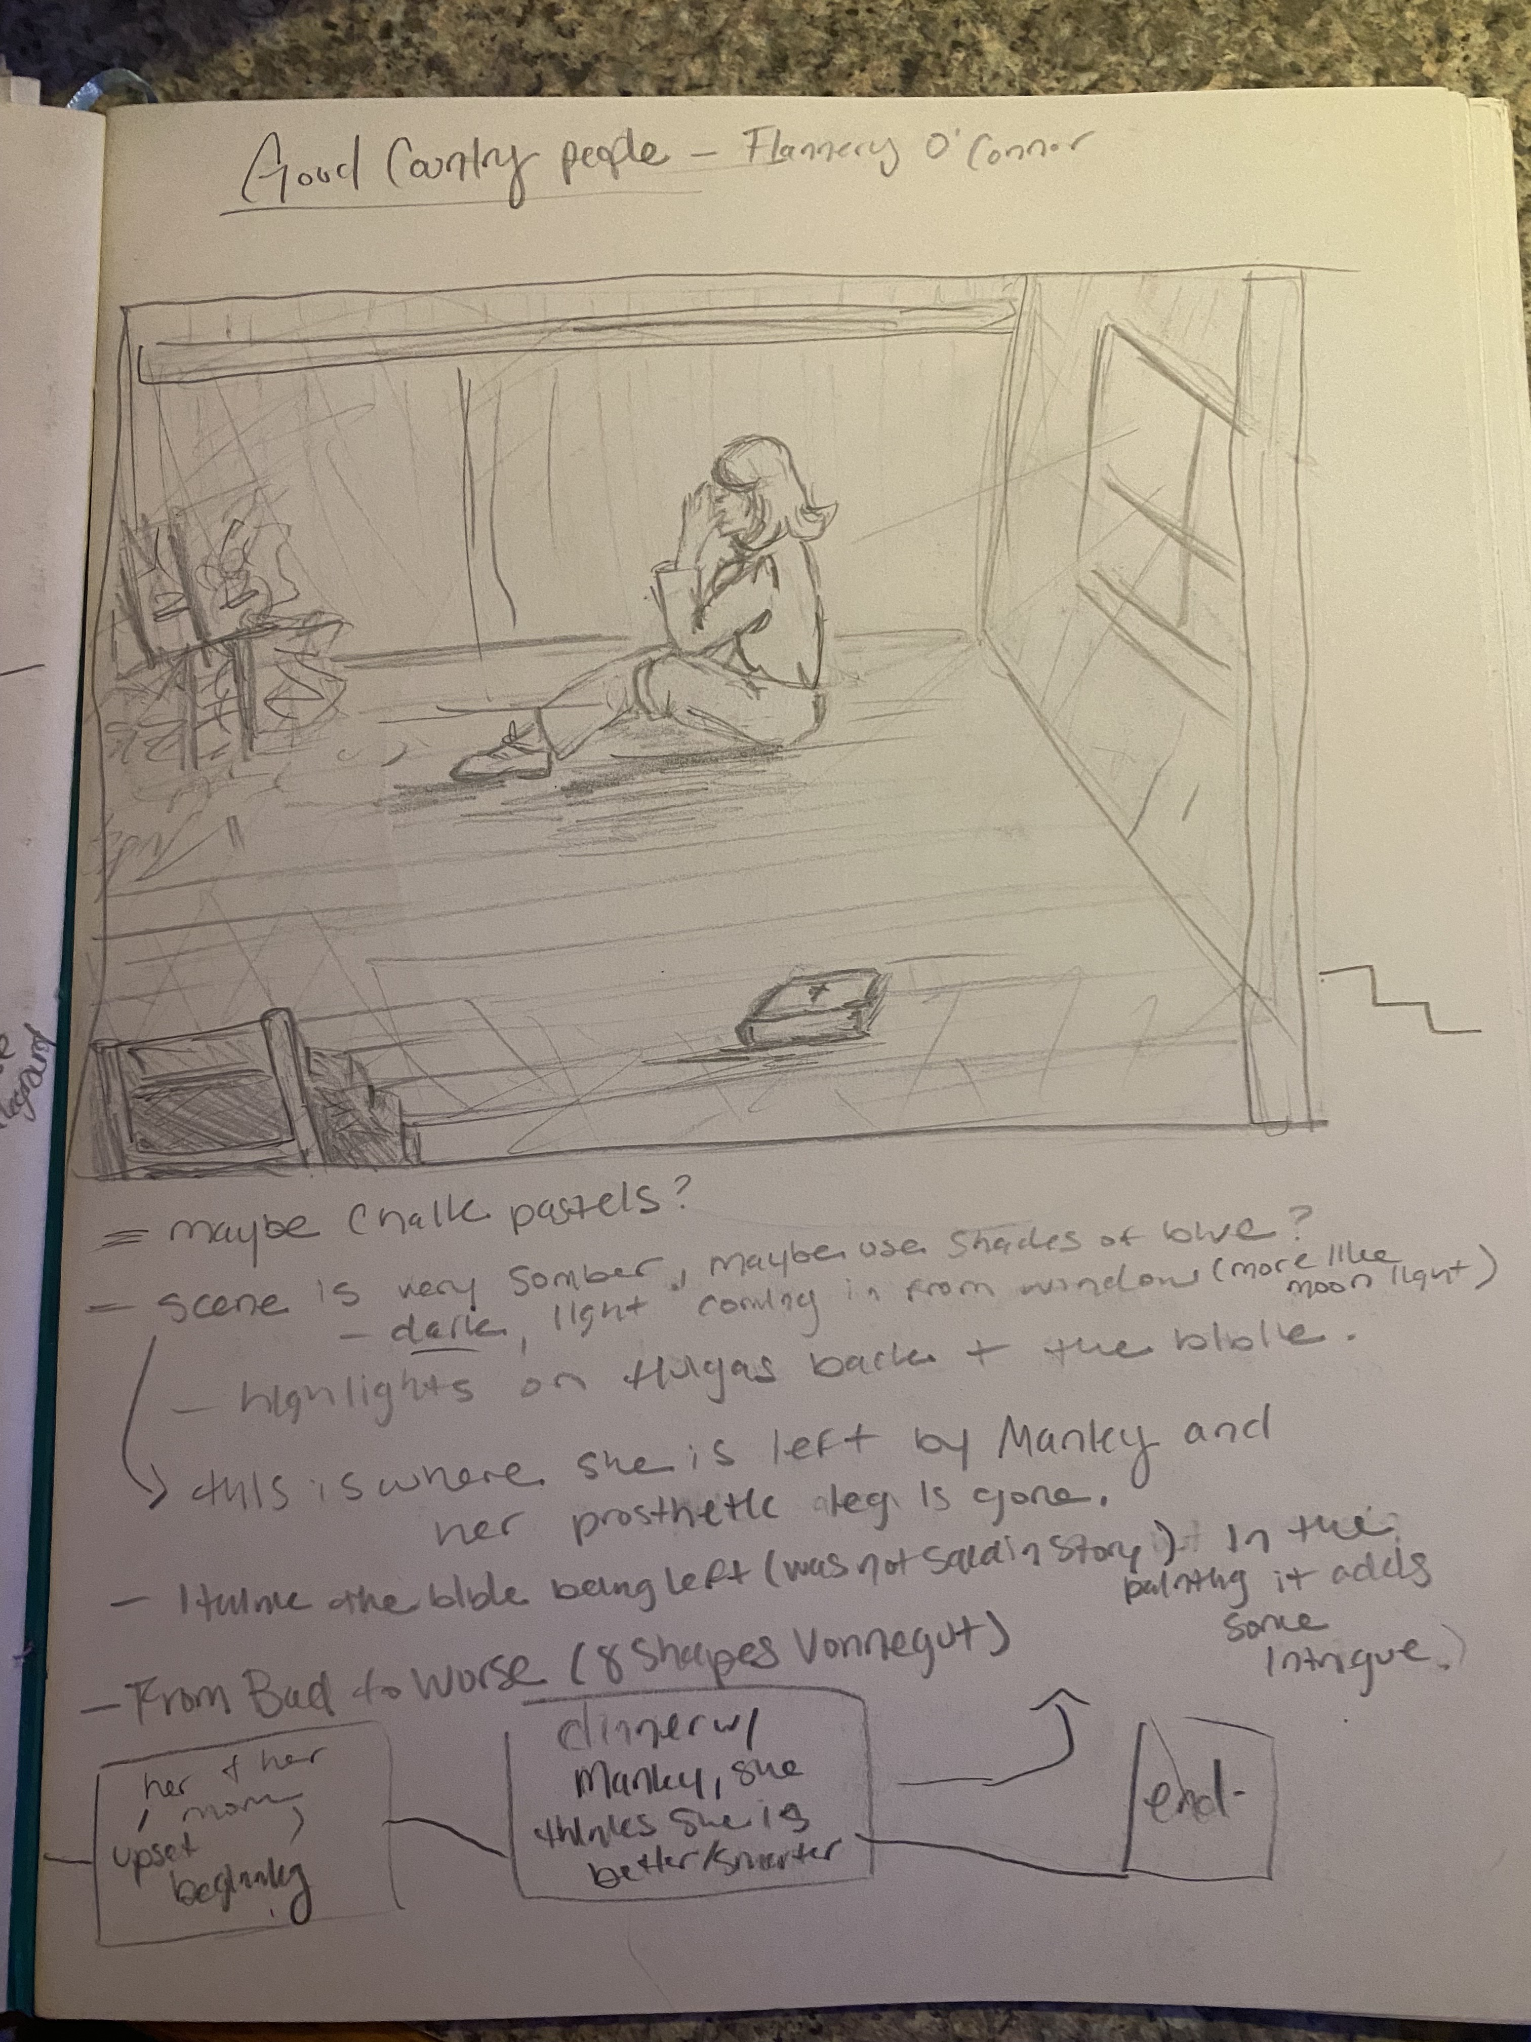
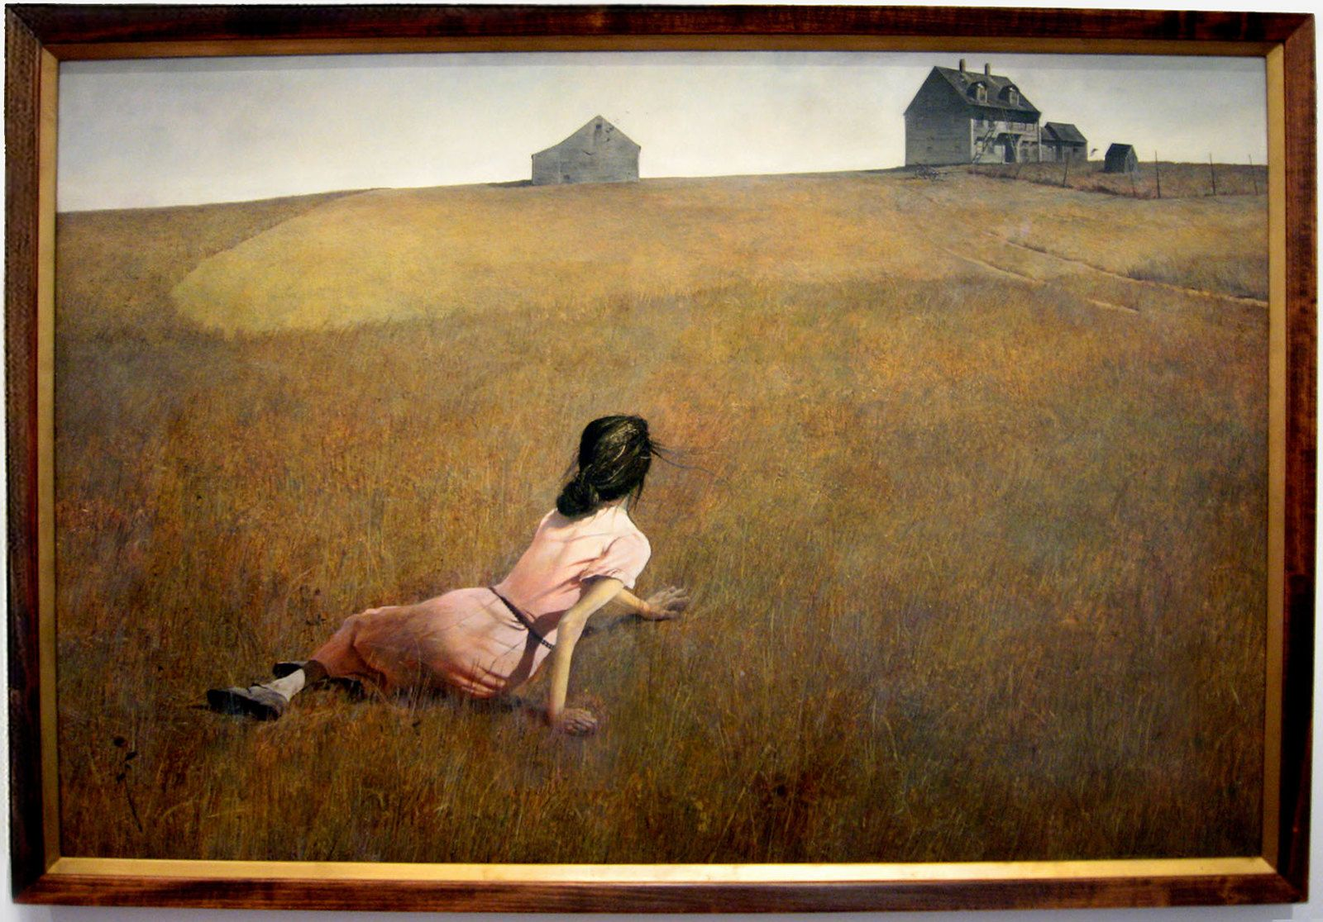
Christina's World, Andrew Wyeth

Slide 21
Which Way is Up?
Sense of ambiguity
Cannot decipher if changes are improvements or not
Plot Line
The story “A Rose for Emily” by William Faulkner could be said to follow this plot shape.
Ex. The Florida Project (2017)

Slide 22
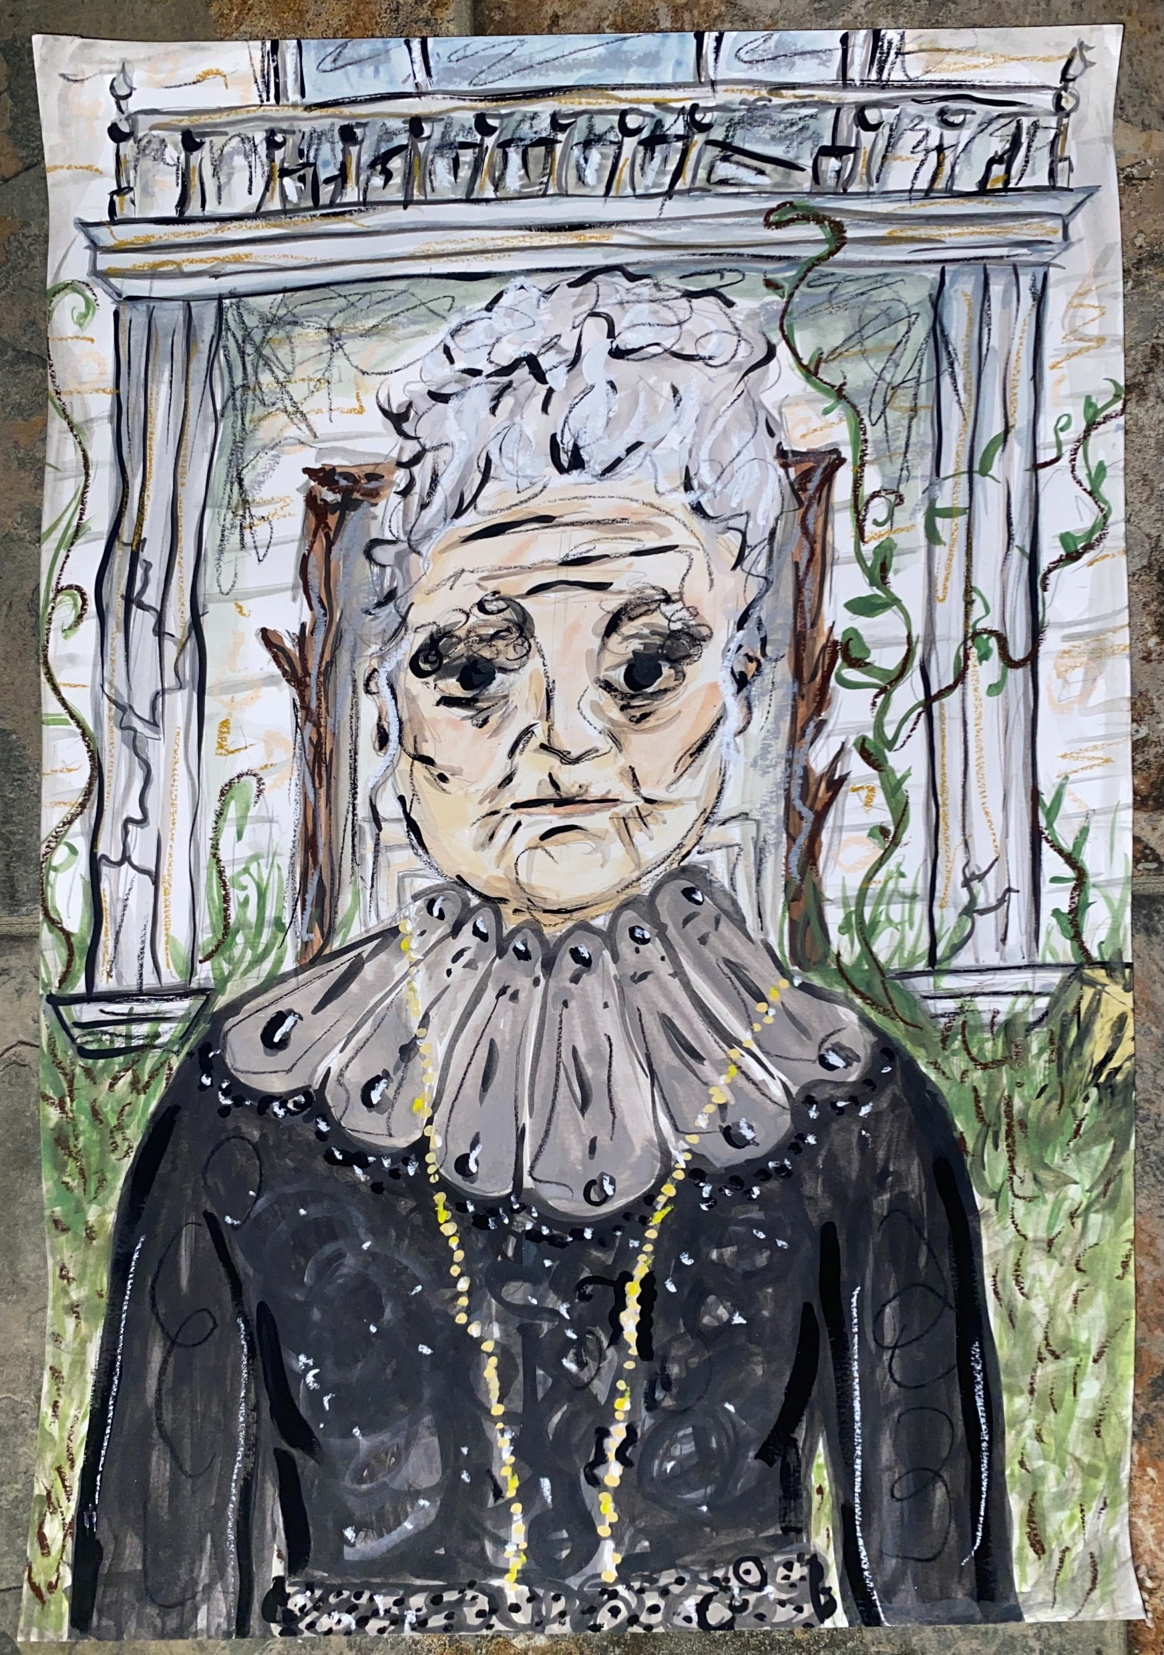
“A Rose for Emily” by William Faulkner

Slide 23
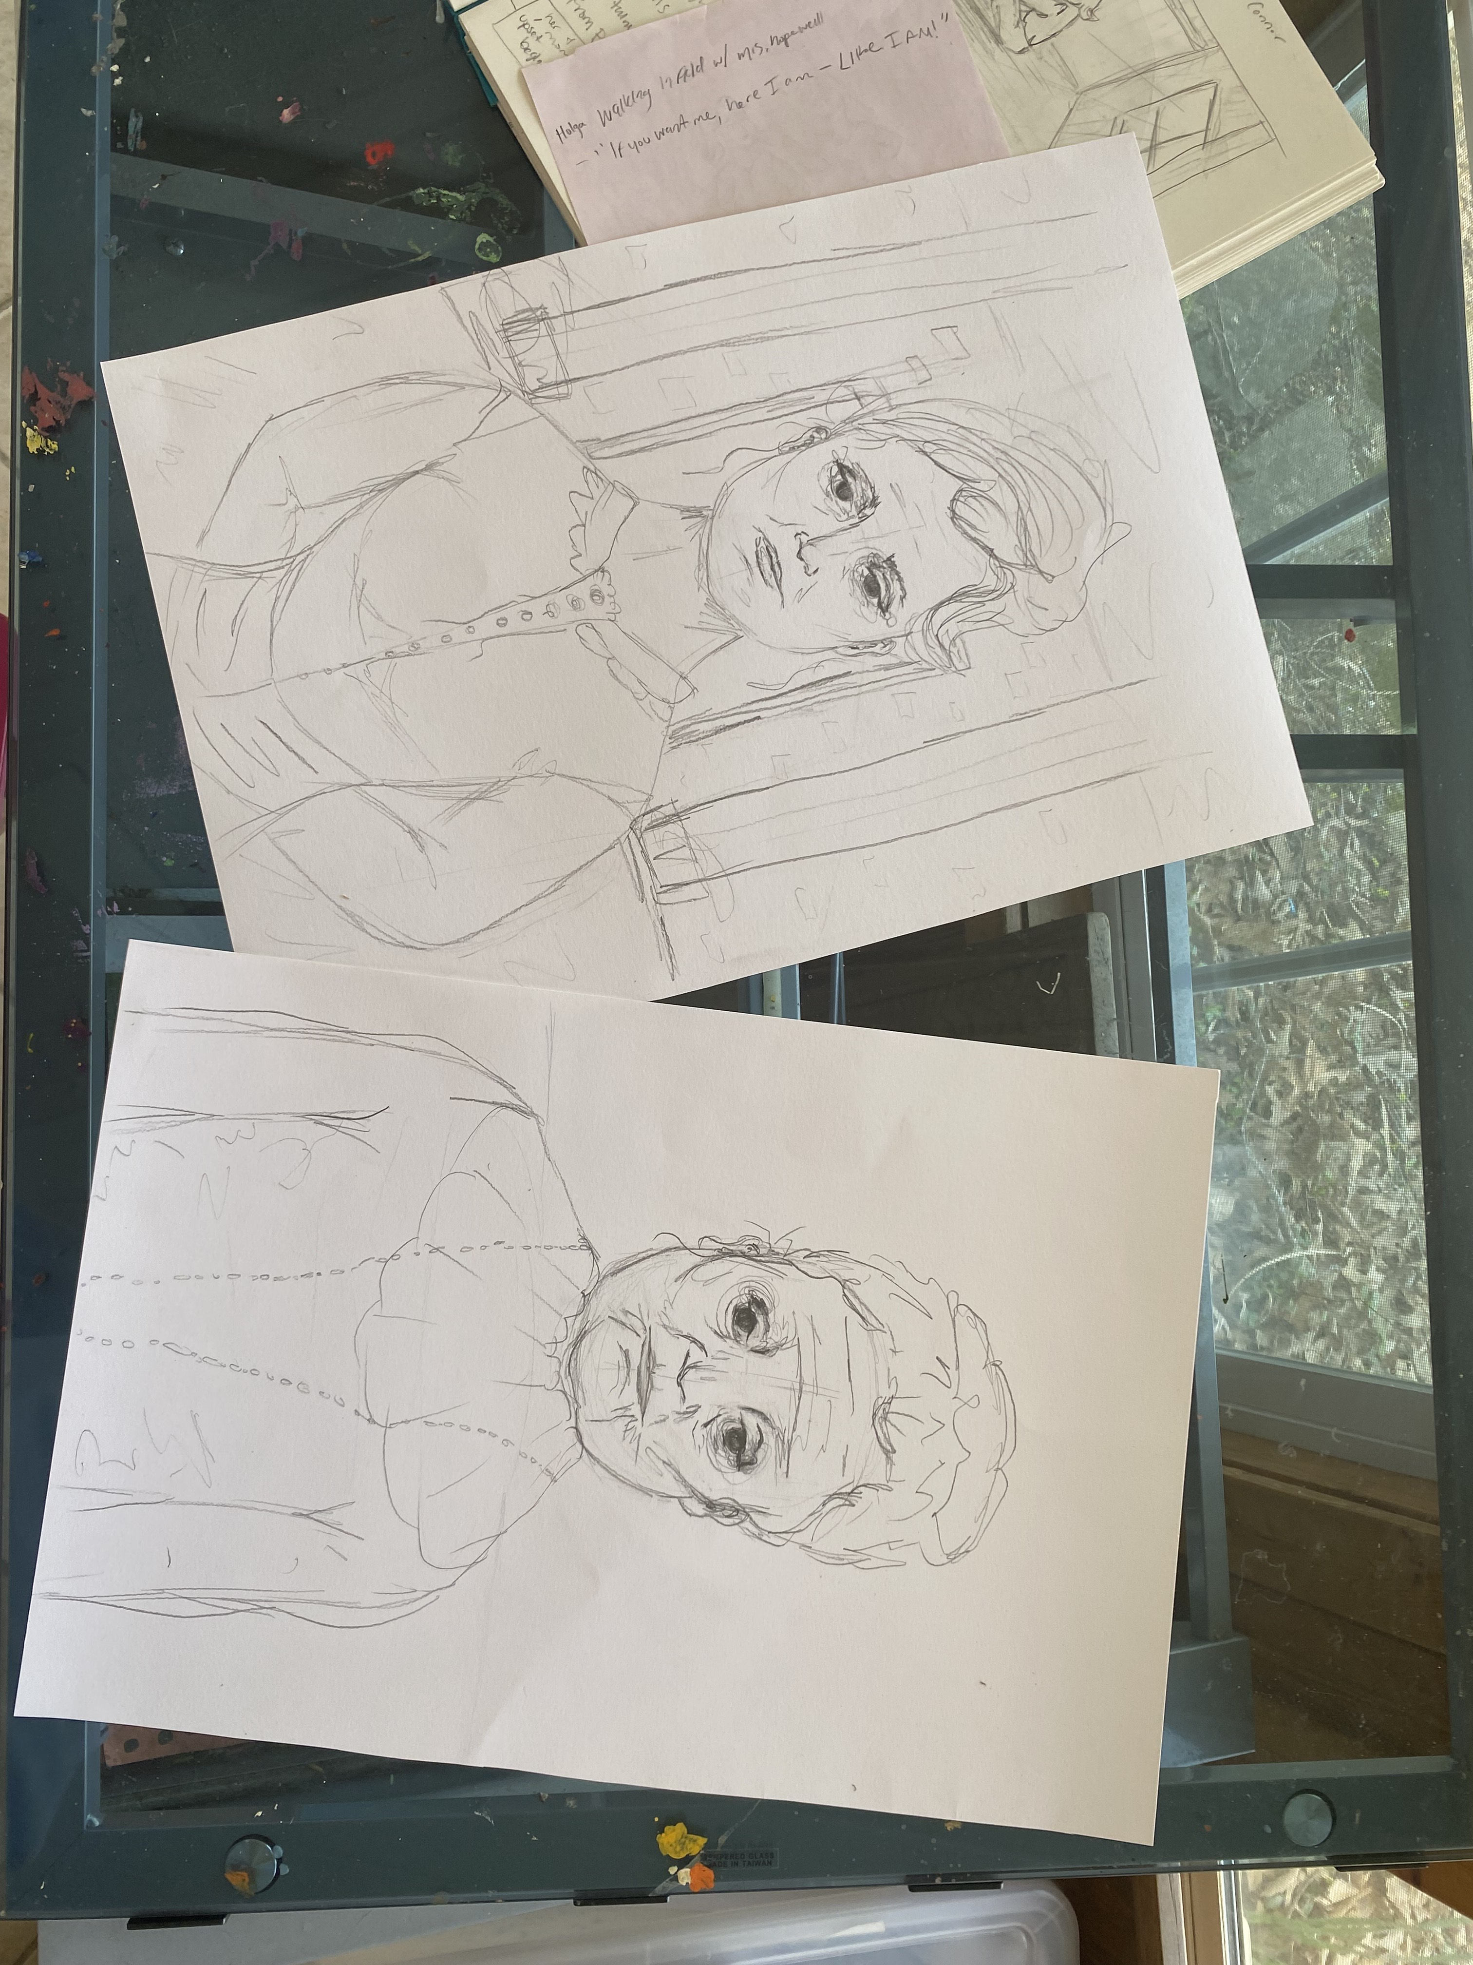
Process of Storyboarding
Which way is up?
Scene choices
Characterization

Slide 24
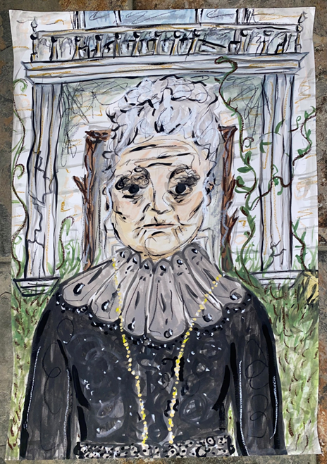
Emily through the years…

Slide 25
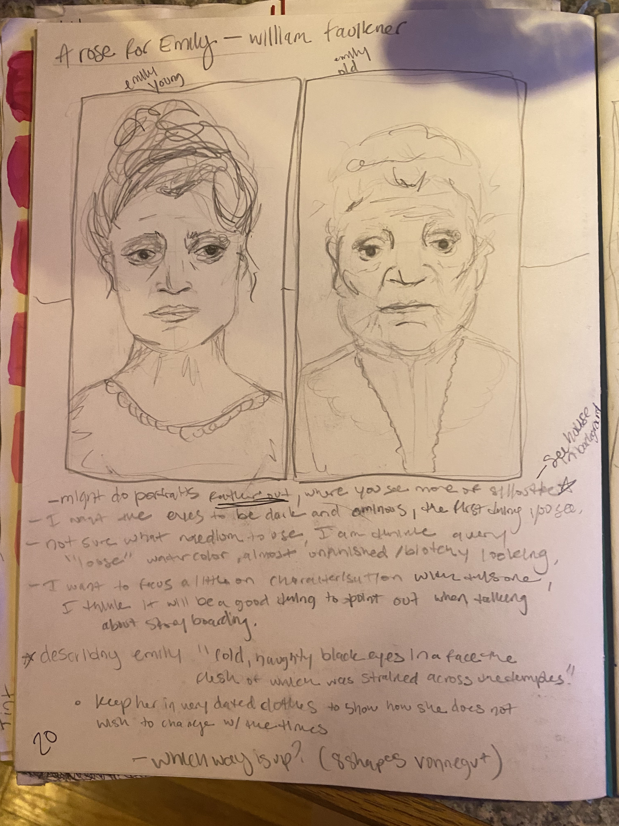

Slide 26
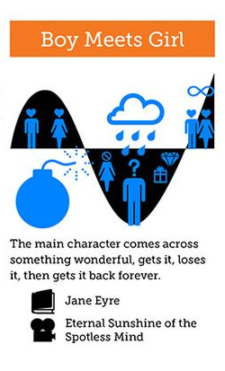
Boy Meets Girl
Not always about a boy falling in love with a girl.
Plot Line
The story "The Gift of the Magi” by O. Henry could be said to follow this plot shape.
Ex. Lemonade Mouth (2011)

Slide 27
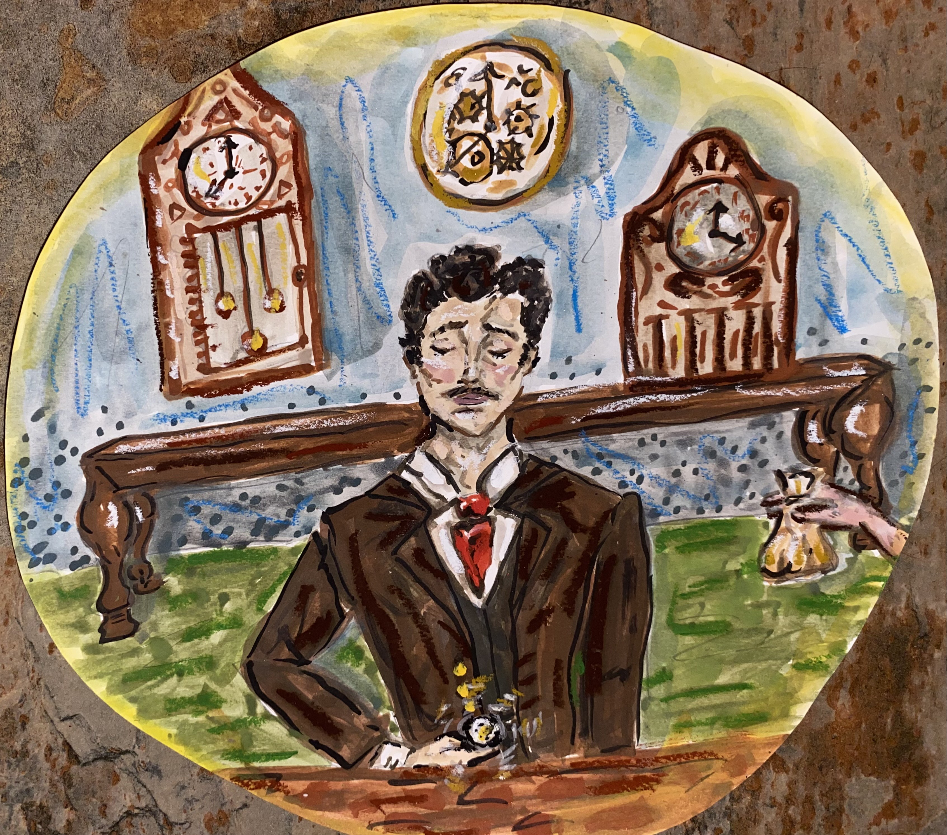
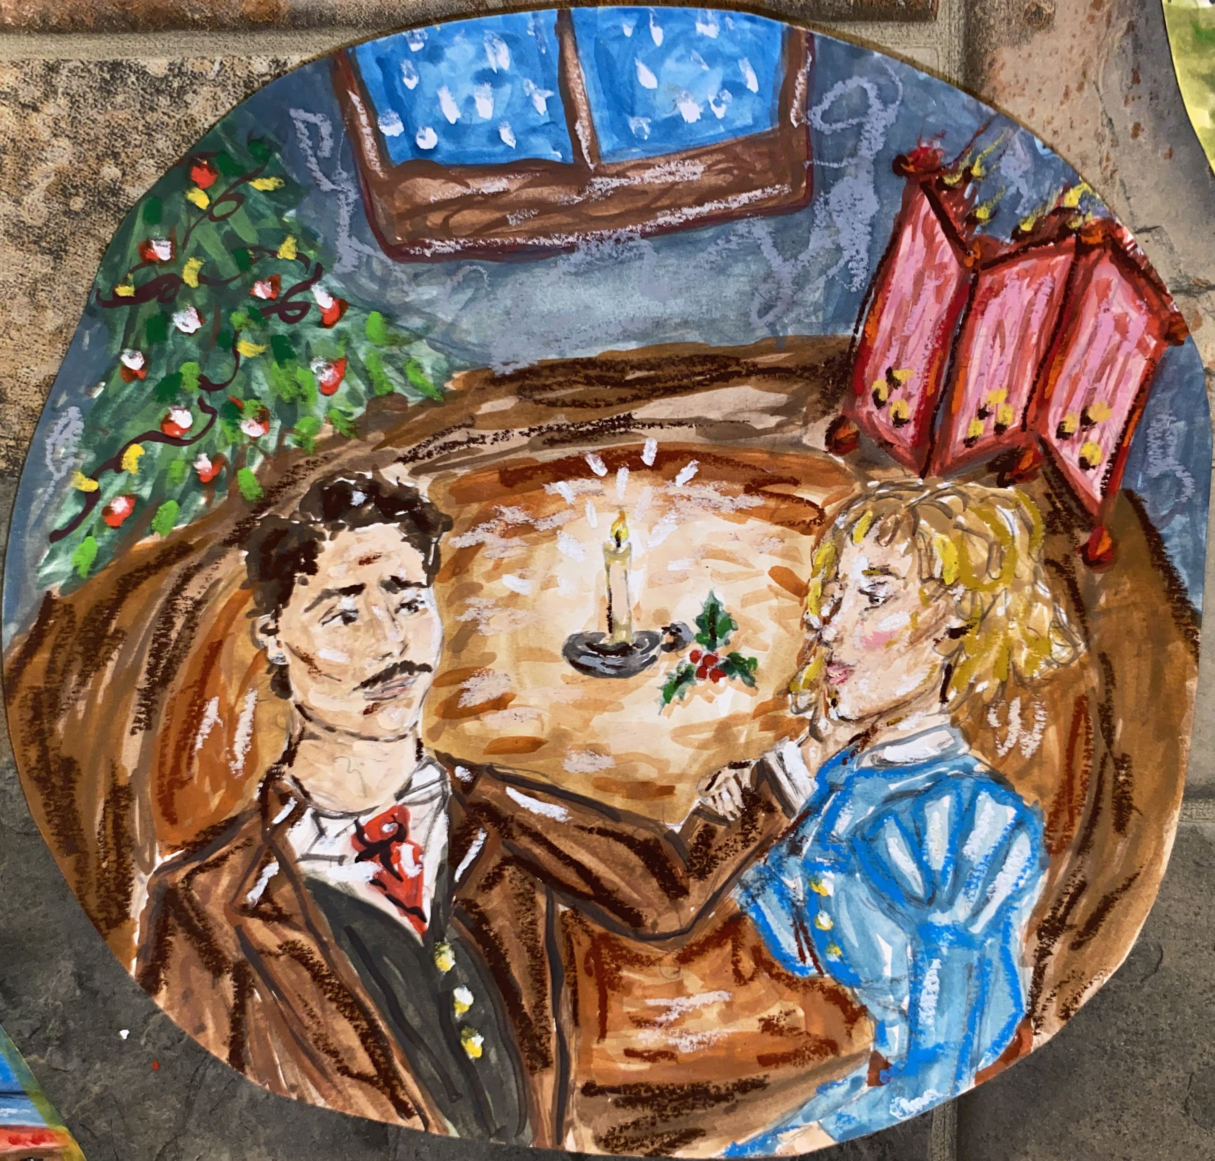
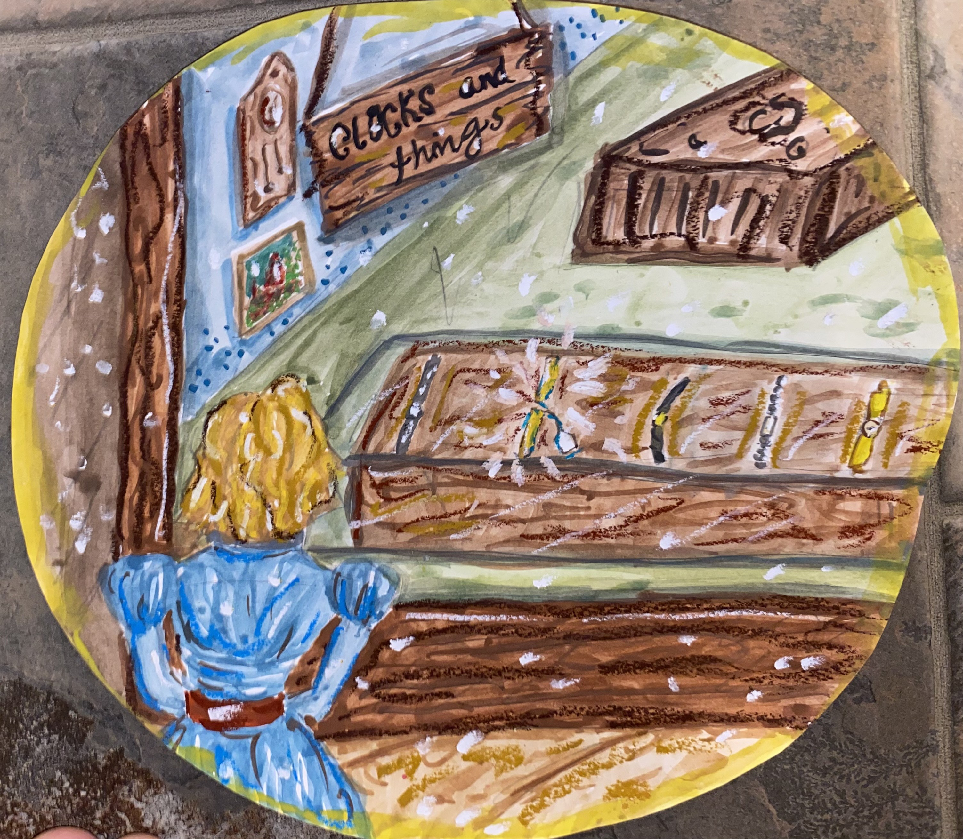
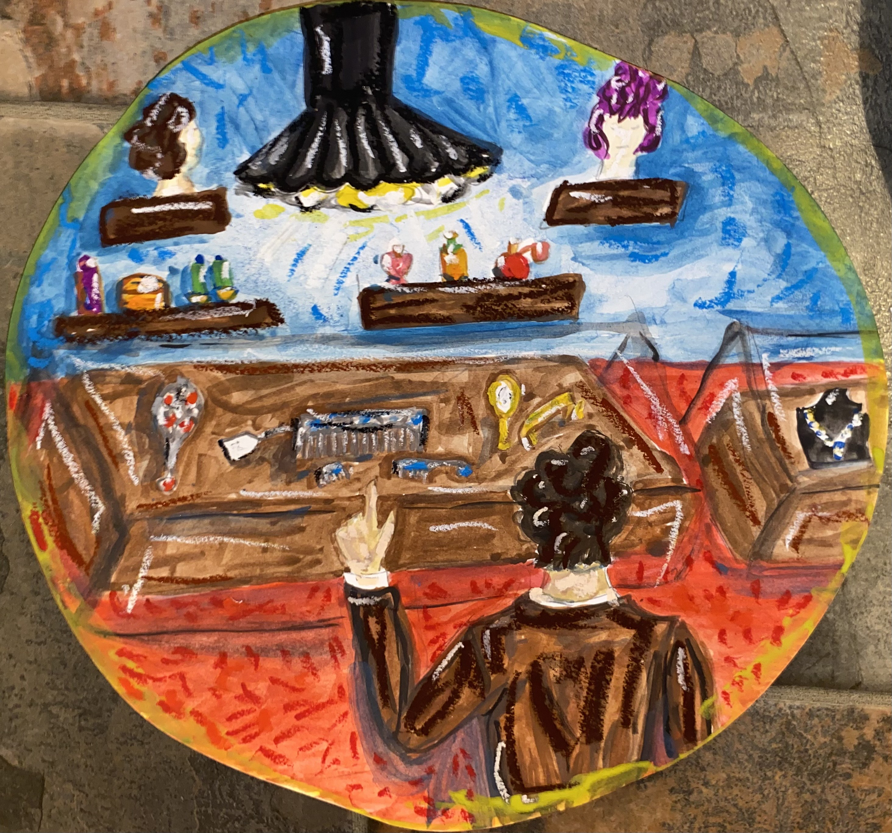
“The Gift of the Magi” by O. Henry

Slide 28
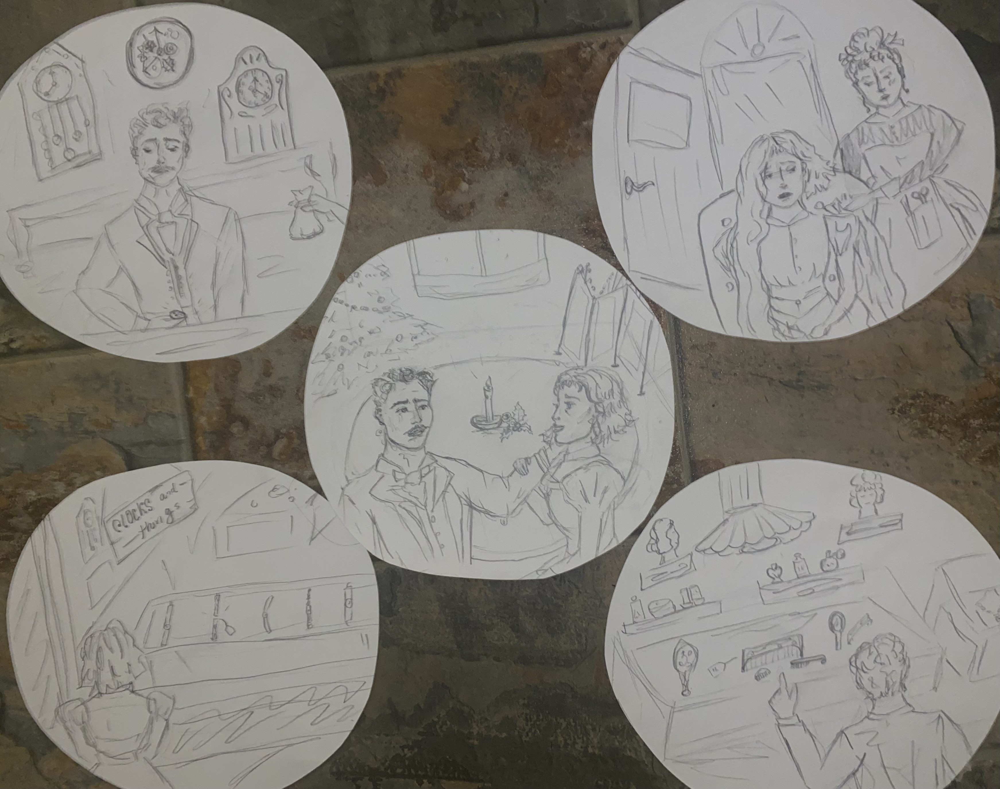
Process of Storyboarding
Boy Meets Girl
Scene choices
Characterization

Slide 30
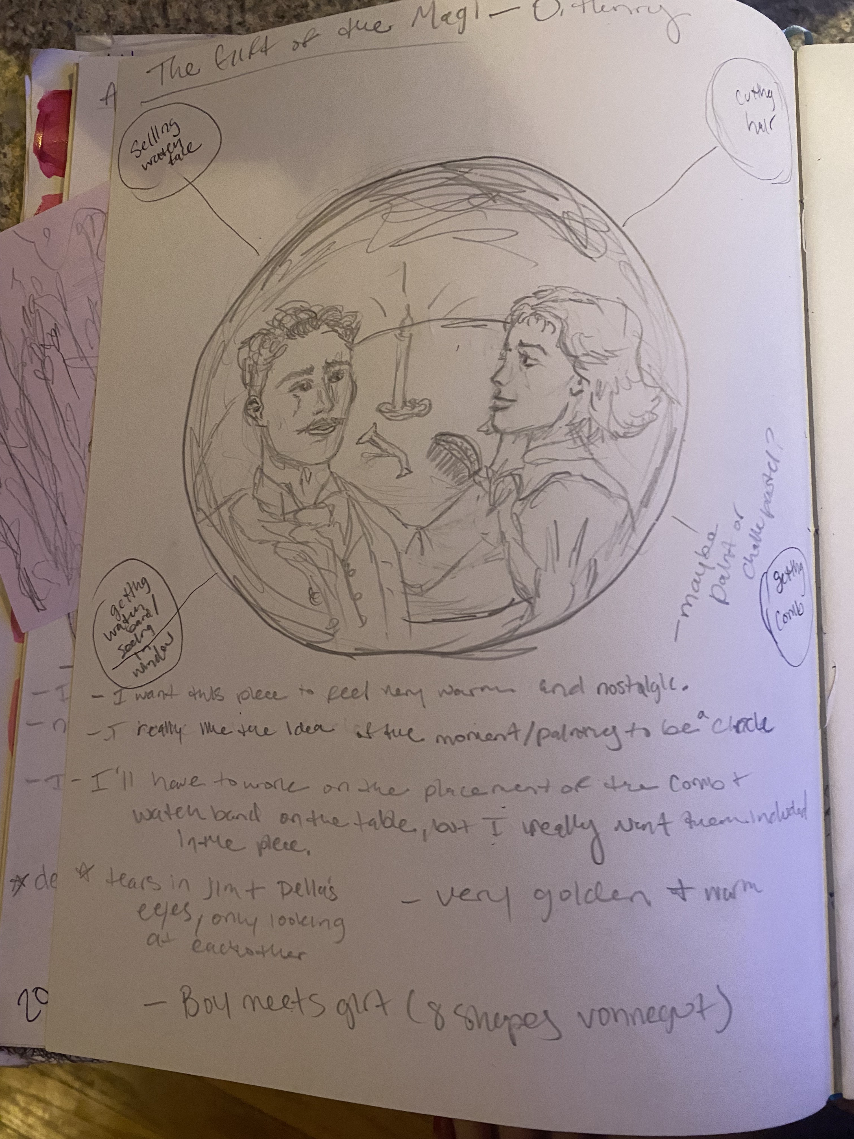
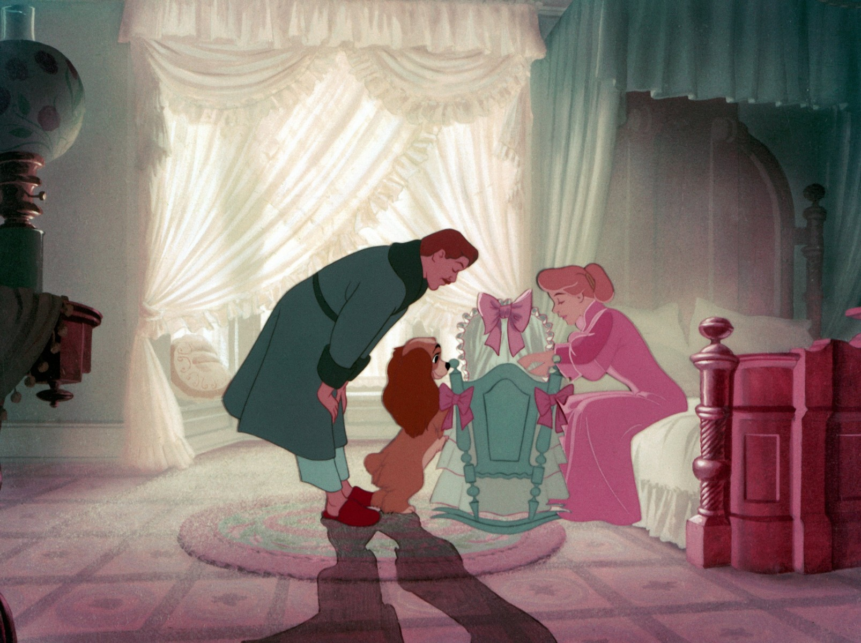
Lady and the Tramp, Walt Disney Studios

Slide 31
What did I expect to find?

Slide 32
Why is it valuable?

Slide 33
References

