Slide 1
https://ugreen.io/sustainable-architecture-a-guide-for-architects-interior-designers-and-construction-companies/
Notes:
Slide 1: Introduction by ASUMH instructor Jessica Clanton.

Slide 2
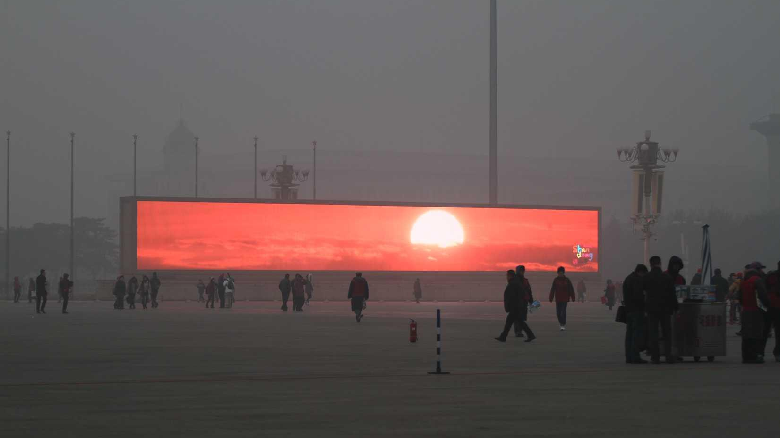
Air Quality
Health
Is relatively good in the USA
Bring up acid rain
LA Smog
Add cause
Acid rain perhaps?
https://twitter.com/yohsyu/status/424183681855401984/photo/1
Notes:
Slide 2: I would like you to put yourself in the shoes of a resident of Beijing. You wake up and take a deep breath, feeling the soot and smog entering your lungs. This is a feeling you’re so used to, you don’t even think about it anymore. You prepare a simple lunch of rice and carp, and head out to work. On your way, you pass a long LED screen displaying a sunrise. The air pollution in Beijing is so thick, the LED screen is your only visual indication of the sunrise.
Transition: For a few years now, I’ve been invested in ways to use architecture and urban planning to create healthier, environmentally friendly places for us to live in. This interest arose from an unexpected place when I was much younger.

Slide 3
"Investment in mass timber project for new student housing" by BC Gov Photos is licensed under CC BY-NC-ND 2.0.
Notes:
Slide 3: With that said, how many of you have played Minecraft, the game shown on the screen here? Yeah, same! For those of you who don’t know, it is a block game similar to legos, and may be something you’ve seen others play. I spent thousands of hours within this game building countless buildings, cities, and landscapes. While many Minecraft fans channel this creativity and interest to go into a career like game design, I instead gained an appreciation of the creativity and importance of urban planning and architecture.
Transition: While Minecraft piqued my interest in architecture, further experience in my life inspired me to use architecture to improve the world, lessen the effects of carbon emissions, and encourage sustainable policies and design practices. I wanted to explore this deeper through the Apex project.

Slide 4
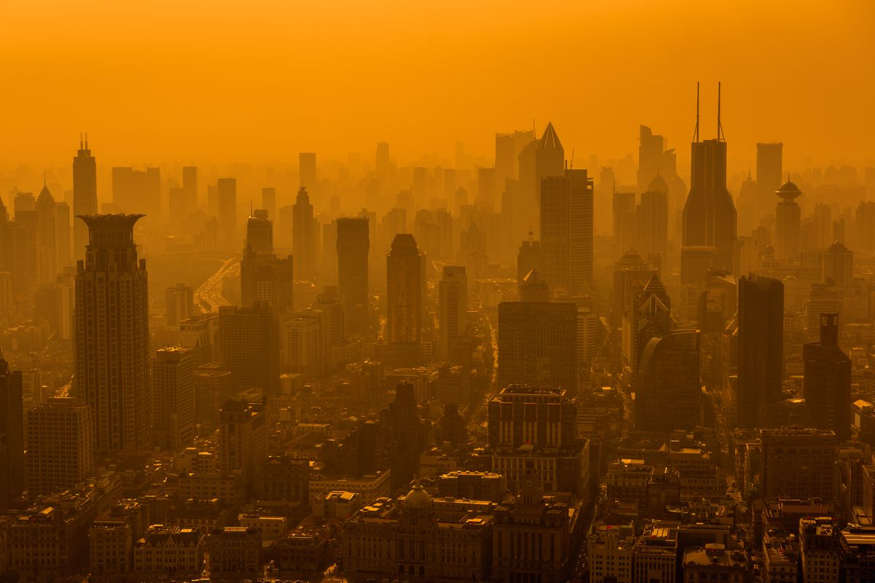
This…
is a problem.
https://www.shutterstock.com/image-photo/shanghai-skyline-smog-424737244
"Shanghai skyline in smog." by r.nagy is licensed under CC BY 2.0.
Notes:
Slide 4: Before starting this project, I understood unsustainability in architecture and urban planning as a set of multifaceted problems—but throughout researching this project, I developed a deeper understanding of the severity of these problems. I also began to understand these issues as a sort of feedback loop that fed upon each other. Outside of these problems, I’ve also gained a deeper understanding of architectural modeling. Many structures that could look simple at a glance are more involved, and many models serve the purpose of displaying an idea over direct beauty.

Slide 5
WHY IS THIS MEANINGFUL
Affects climate change
Decreasing biodiversity
Financial cost
Loss of life
"Storm water runoff" by Albertoblaq is licensed under CC BY-SA 4.0.
"Storm water runoff" by Albertoblaq is licensed under CC BY-SA 4.0.
Notes:
Slide 5: Now, why is all of this meaningful? Why does it all matter? Well, unsustainable policy and living can lead to a loss of human and animal life, increase costs, and decrease quality of life.
Transition: Many of these problems overlap. Let’s go over some of the main ones.

Slide 6
https://www.cnbc.com/2019/09/04/commuters-in-this-city-spend-119-hours-a-year-stuck-in-traffic.html
Notes:
Slide 6: Problems Slide - Before we do, though, I’d like to highlight this image. This photograph demonstrates several of the problems I will discuss, and the importance of addressing problems that we may not immediately recognize as consequential.

Slide 7
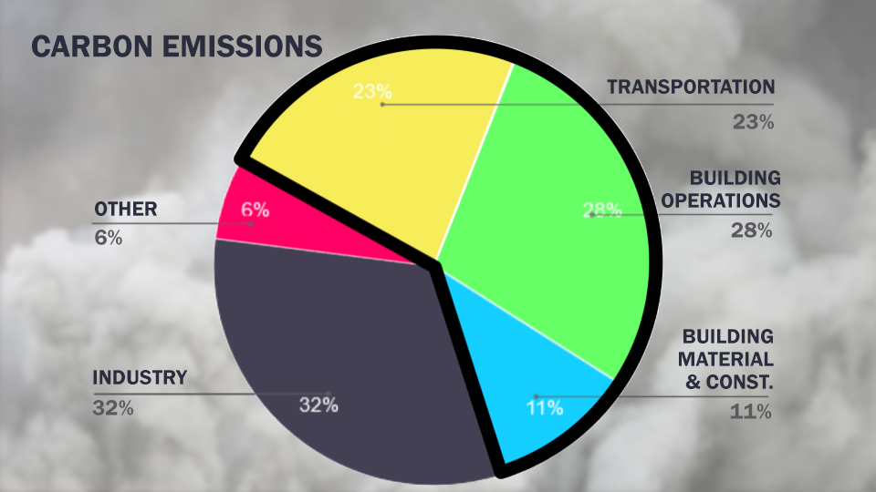
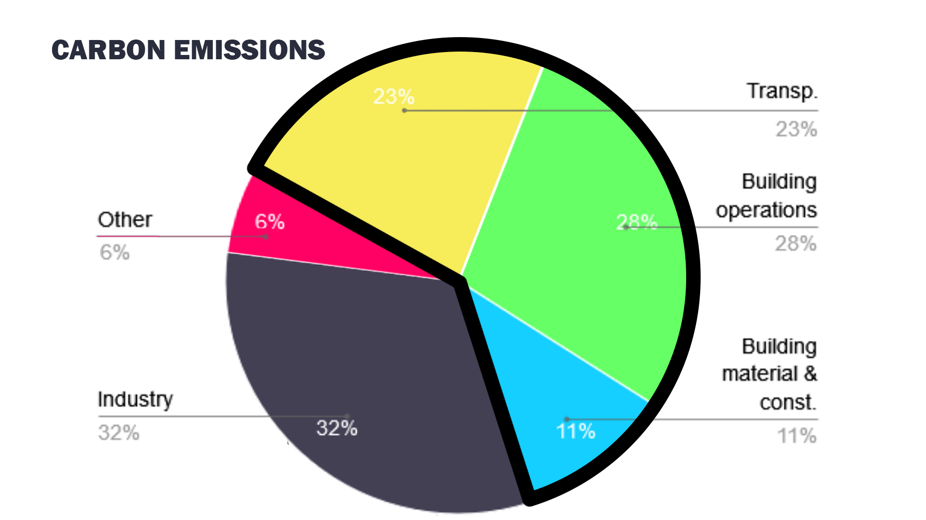
Notes:
Slide 7: Our first, all encompassing problem is carbon emissions. While transportation, building construction, and upkeep make up two thirds of the pie chart, they are integral developments and resources to the beating heart of any city. The solutions presented later have the potential to positively impact this massive portion while not damaging these sectors.
Transition: Unchecked carbon emissions contribute to a phenomenon called the heat island effect. These problems are exacerbated in places like Phoenix, Arizona, and Beijing, China, but also impact small towns like Mountain Home.

Slide 8
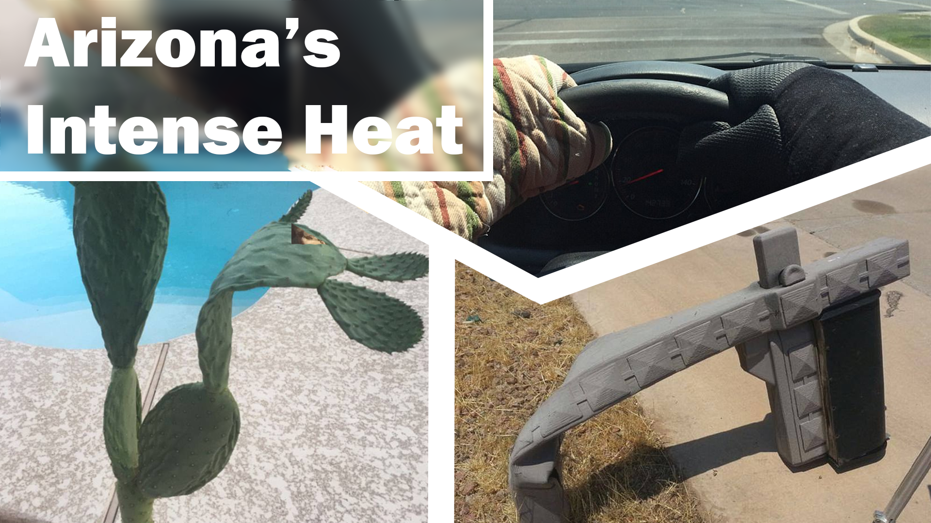
Pictures show that Arizona was so hot that cacti wilted | Daily Mail Online
Notes:
Slide 8: Who’s heard about the heat in Phoenix? You may have seen people on social media talking about their trash cans melting, or cooking an egg on the sidewalk. The use of oven mitts because their steering wheel is too hot. Cacti so dehydrated they wilt, and mailbox stands bent over to the sidewalk. Sure, Phoenix is extraordinarily hot—but it’s hotter than it would be without a prevalence of concrete and black top, the kinds of materials that are able to absorb the visible light from the sun and reemit it as heat. This phenomenon is called the “heat island effect,” which is an increase in urban temperatures due to this concrete and blacktop, but also a lack of green spaces to dampen the temperature. This increase in ambient heat contributes to similar injuries to humans, like heat-stroke, but also requires more reliance on air conditioning, which puts out “super-pollutants,” also called “short-lived climate pollutants.”

Slide 9
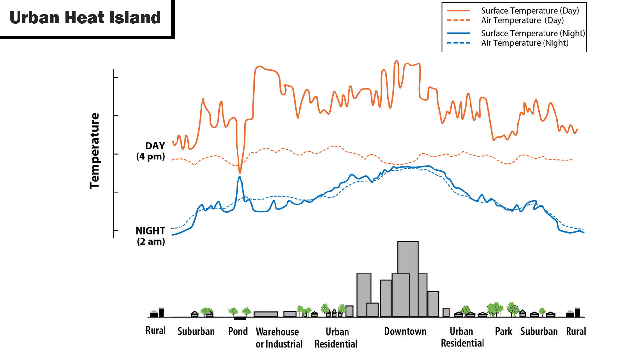
Heat Island Effect
Lack of green spaces
Urban areas with increased temperatures
Deaths in regards to that
Reference Texas
Add cause
USGS. Public Domain. https://www.usgs.gov/media/images/urban-heat-islands
Notes:
Slides 9 & 10: To better understand the heat island effect, I’d like to present this graph from the U.S. Environmental Protection Agency. It represents how temperature can increase or decrease within local areas of development. At the top right, there is a legend that shows the symbols that will be used for surface and air temperatures for both the day and night, while at the bottom, it lays out different types of development, such as rural, parks, and an urban downtown. (Move to the next slide.)

Slide 10
Heat Island Effect
Lack of green spaces
Urban areas with increased temperatures
Deaths in regards to that
Reference Texas
Add cause
USGS. Public Domain. https://www.usgs.gov/media/images/urban-heat-islands
Notes:
Slide 10 (Lines now showing.) This sort of information is important so we can pinpoint ways to decrease the severity of the heat island effect. While this heat increase is worst within high density urban areas, it’s also noticeable in suburban spaces, which is similar to the urban planning practices we see in Mountain Home and its surrounding towns. Natural spaces like ponds and parks act as a heat sink, as demonstrated on the graph by a decrease in temperature during the day. This can act as effective counterbalances for cities—yet most cities don’t account for parks, nor land use for diverse flora.
Transition: While these heat islands are worsened by the lack of green spaces, concrete jungles also strangle the decreasing biodiversity the planet faces.

Slide 11
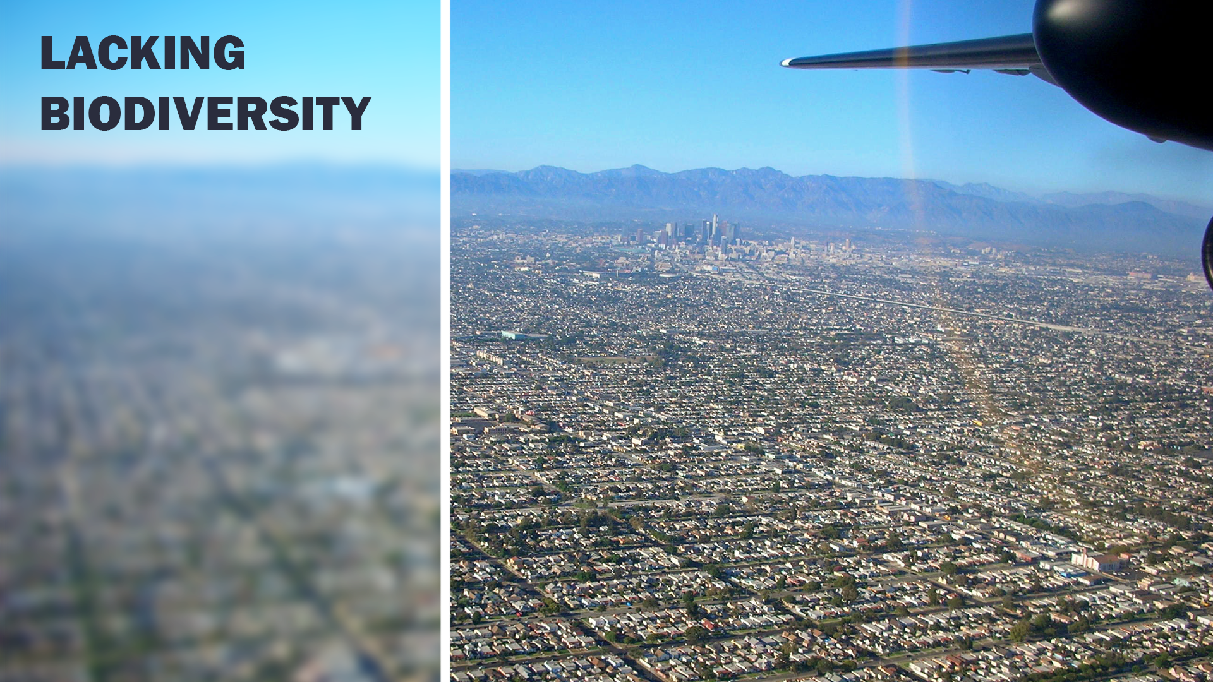
Cause: Urban sprawl
Up to a billion birds a year
Green spaces
Mental health impacts
"Urban Sprawl -- Los Angeles" by ATIS547 is licensed under CC BY-NC-SA 2.0.
Notes:
Slide 11: This lack of biodiversity affects everyone and everything. As our development focuses more on urban sprawl and suburban development, it splits ecosystems in half. I’m sure some of you in this room have heard a bird hit your window at some point? It is only one example of many, but up to a billion birds in the United States die yearly due to being unable to understand that a window is a barrier. The CDC even encourages the inclusion of parks and increased access to nature to help with people’s mental health.
Transition: Not only is a lack of biodiversity or green spaces a problem, but so is poor air quality, which it contributes to.

Slide 12
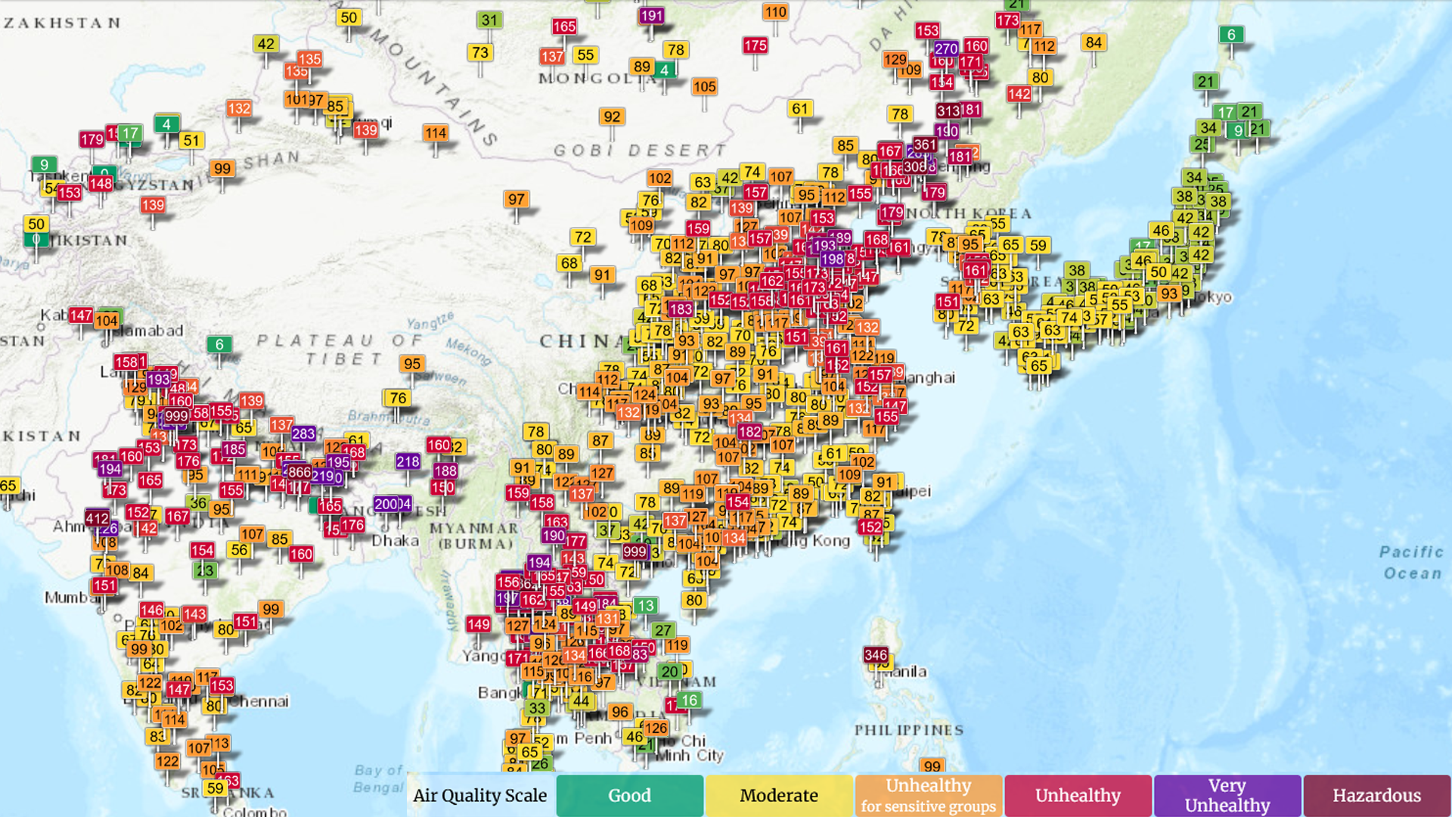
Air quality reference india/china
Notes:
Slide 12: Do you recall the story at the beginning with the digital sunrise? That level of air pollution isn’t foreign to the United States. Nowadays, as shown up here, China and India experience the worst air quality in the world. It is outright hazardous and can lead to sickness, cancer, or problems that we barely see today like black lung. The sections in orange, red, and purple really indicate the severity of air pollution within this part of the world. For those of you in the audience that are colorblind like me, the higher numbers indicate worse air quality. (Use pointer to point out higher numbers.)

Slide 13
Notes:
Slide 13: If we are to compare this to the current air quality map of the United States, the worst we see is that it can be unhealthy for sensitive groups. Now, that’s not GOOD, but it’s a lot better, comparatively. We still see smog, like Los Angeles occasionally has, as well as some other urban centers, but it is critical to emphasize that this radical difference in air quality is because the United States has enacted policies to lower air pollution. The Clean Air Act, which was revised in 1990, specifically tackles acid rain, urban air pollution, and helped to phase out ozone-depleting chemicals as required by the international Montréal Protocol.
Transition: Now that we recognize several of the problems, we can begin to look upon solutions for a better tomorrow.

Slide 14
Solutions
Notes:
Transition: We will look upon some of the larger scale solutions, such as urban planning, and work our way down to small scale solutions that each and every one of us can do on our own.
Slide 14: These solutions I offer are influenced by our choice and our votes. We have a lot of direct and indirect control to better the world around us. We are already seeing policies enacted and trends slowly leaning in favor of sustainability. All we need to do is keep pushing.

Slide 15
https://upload.wikimedia.org/wikipedia/commons/a/aa/Map_of_the_City_and_Suburbs_of_Montreal_-_1825.png
Notes:
Slide 15: Urban Planning at its core is how towns and cities are designed. Where you’re allowed to build a house compared to a business is a good example. It’s all encompassing by its very nature.
Transition: Part of specifically sustainable urban planning is reducing the surface area of concrete, which contributes to the heat island effect and carbon emissions. One way to approach this is by tackling parking minimums.

Slide 16
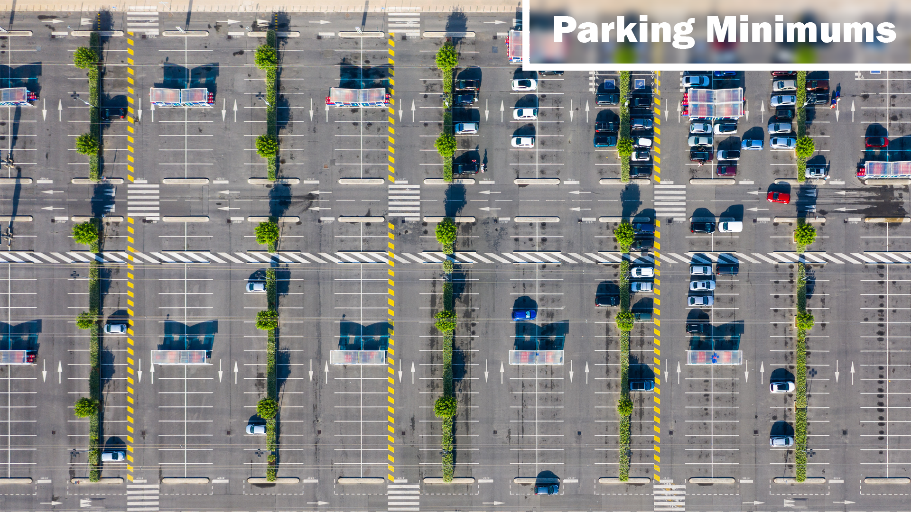
Parking Minimums
https://www.strongtowns.org/journal/2015/11/18/mapping-the-effects-of-parking-minimums
https://smartgrowthamerica.org/tag/parking-minimums/
Notes:
Slide 16: Parking minimums are codes that require businesses to include a certain number of parking spots. While this may be necessary for some companies like Walmart, you’re just as likely to go to a restaurant with a near empty parking lot. Allowing businesses to choose for themselves how much parking may be needed, or to rely on a communal area for parking, can lessen concrete use, lower the intensity of the heat island effect, and lessen carbon emissions by decreasing how much concrete is used. Fayetteville, the first city in the United States to remove the parking minimum requirements, is a fantastic example of its effectiveness, where many people see firsthand the benefits of the policy shift.
Transition: While decreasing parking spaces may be helpful for sustainability, it is important to ensure all individuals can move where needed. Luckily, there are a few easy solutions that are also better for the environment.

Slide 17
Karl Jilg Illustration Reveals How Much Space Is Given to Cars (businessinsider.com)
Notes:
Slide 17: To begin discussing these solutions, it is important to understand what I’d call “Democracy of Transportation.” While we have car sharing options, we must still rely on the car for transportation. Other, more cost effective options we could implement in more populated areas are buses, trams, and subways. Even in less populated areas, ensuring protected bike lanes, pedestrian paths, and sidewalks allow people to “vote” by choosing how they’d like to get places. This can help carbon emissions by discouraging car use, but it helps not only disabled people, but those without access to a car.
Transition: So, I began this project last semester while I still had the privilege to move mostly where I wanted. I had surgery on my left knee a few weeks ago, and it has actively affected how I exist anywhere. I can only imagine how much more my life would have been affected if the surgery was on my right knee. It would’ve made driving my car nigh impossible. I’m lucky I can drive right now, but not everyone can say that. While it may be self-evident that public transport can benefit someone similar to me, there are a number of extra benefits it brings.

Slide 18
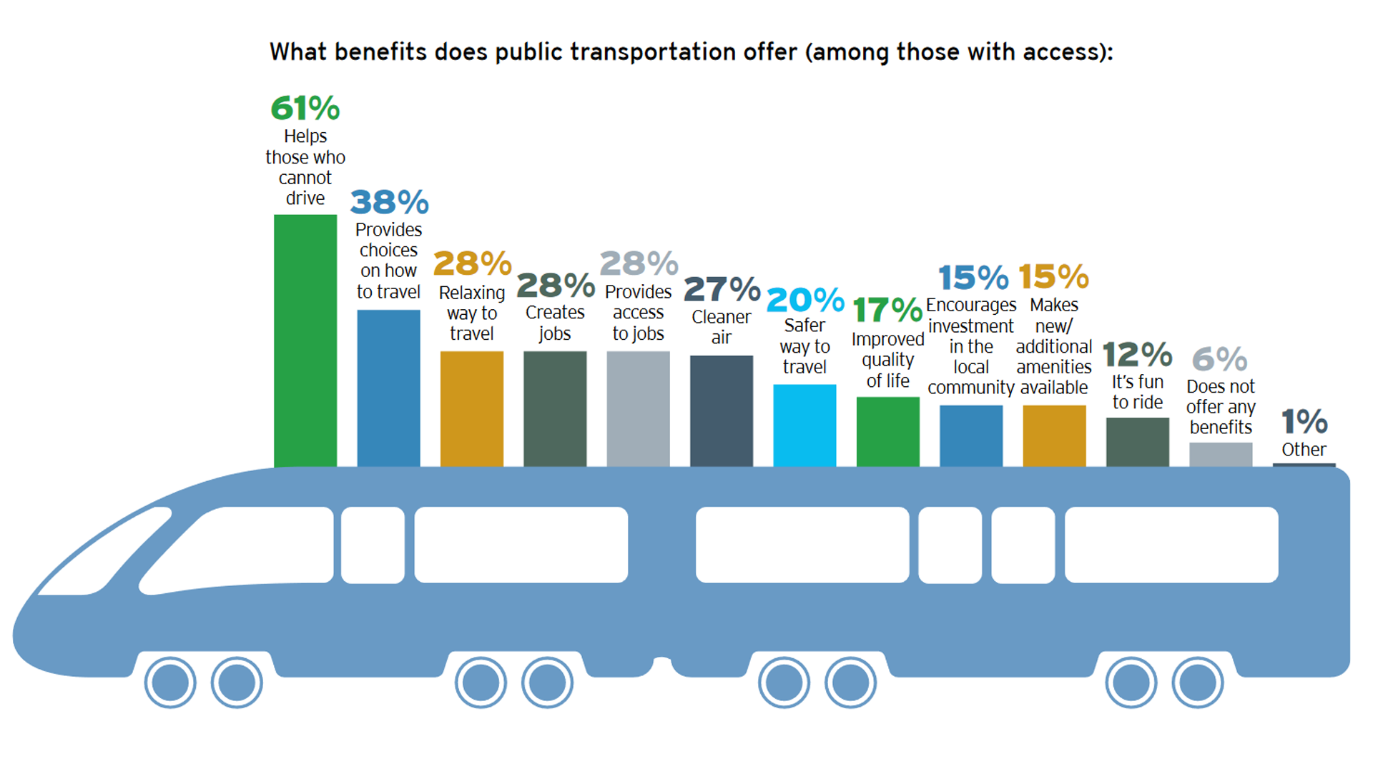
Less reliance on cars
https://www.hntb.com/wp-content/uploads/2019/11/America-THINKS-2017-Compilation.pdf
Notes:
Slide 18: This is a survey from Think: Infrastructure Solutions. They surveyed a thousand Americans across the nation to compile what the average American believes the access to public transport can bring. While it highlights several benefits I’ve mentioned like cleaner air, or a choice in how to travel, many survey respondents do believe public transportation offers benefits like investments into local communities and job creation.
Transition: While public transportation and walkability is a personal passion of mine, we also need to bridge the gap between us and nature and heal our decreasing biodiversity.

Slide 19
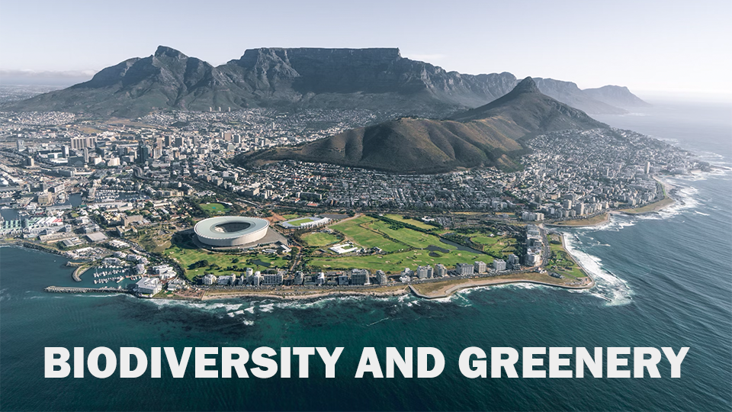
Biodiversity and Greenery
https://unsplash.com/photos/aerial-view-of-city-near-mountain-during-daytime-1GgWbP74phY
Notes:
Slide 19: Mention Highrise model. On the screen is an image of Cape Town. Located in South Africa, it is considered by the City Nature Challenge to be the most biodiverse city in the world. The City Nature Challenge is a collaboration run by science teams in California that help record and document information sent in by volunteers about wildlife in cities. While the mountains and ocean are a boon for that city’s biodiversity, Mountain Home isn’t dissimilar. We’re surrounded by two lakes, a river, and even sit within mountains. Larger cities can add vertical gardens, massive parks, and more, but Mountain Home can echo some simpler techniques. We can add a length of trees along our roads, reintroduce native plants in our downtown, or look to our outskirts. While simple, this offers places for animals to live and stores carbon from plant growth. The dozens of squirrels that live on this campus is a good indication of the shelters we can provide.

Slide 20
"We head into an animal crossing bridge on Hwy One" by spelio is licensed under CC BY-NC-SA 2.0.
Notes:
Slide 20: Raise your hand if you have, or almost ran over animals during your travels…. Yeah, that heavily impacts our wildlife. The implementation of green animal crossings with supplemental fencing can decrease the number of vehicle-animal collisions by over 80%. This number came from Parks Canada, which has collected this information for nearly three decades now, showing long term effectiveness in guiding animals away from our roads, how to rebuild populations that have depleted for decades, and how to keep people safe with less accidents.
Transition: While city and county governments can do much through policy to create a large impact, there’s much you can do individually.

Slide 21
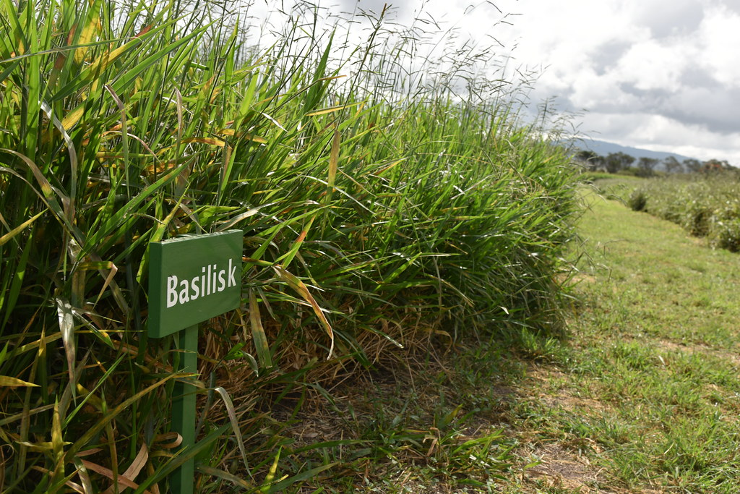
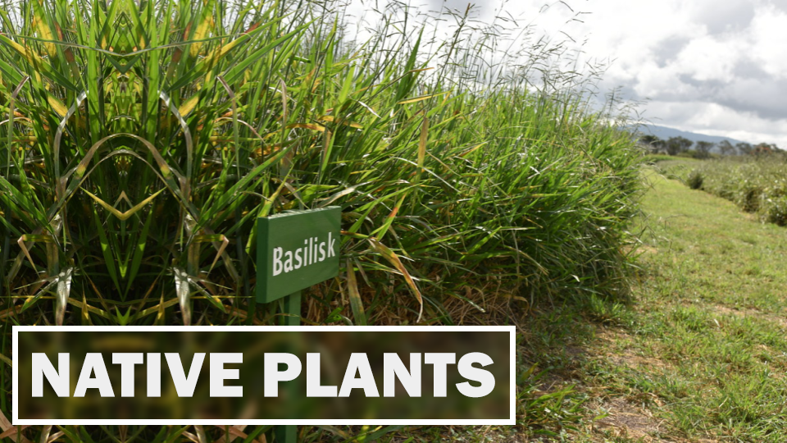
Native Grasses and Plants
"Basilisk variety of Brachiaria grass at ILRI's Kapiti Research Station" by International Livestock Research Institute is licensed under CC BY-NC-SA 2.0.
Notes:
Slide 21: Many people here live in single family homes. These are buildings a small family, or several roommates can live in. Because these tend to have yards, you can contribute by planting native plants! Adding bushes like Yaupon holly, planting currently endangered native magnolia trees, and encouraging a small ecosystem in your front or backyard can give a small part of the world back to the nature we took it from. Officially, this sort of landscaping and intentional planning is viewed as a type of landscape architecture.
Transition: While landscape architecture focuses upon the land around us, how we design our buildings is also incredibly important.

Slide 22
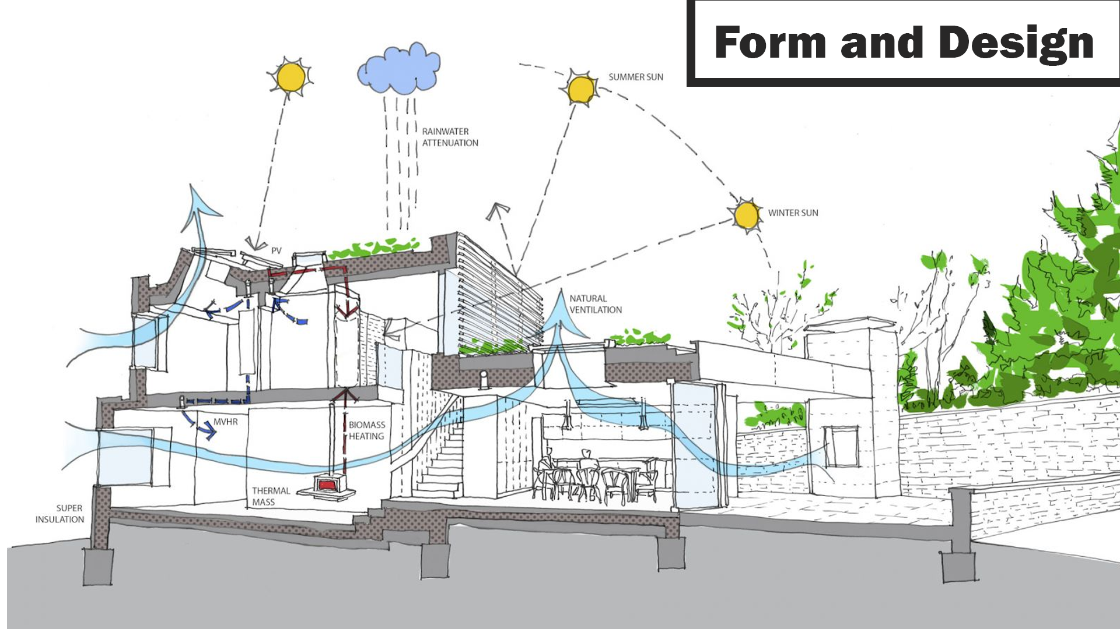
Notes:
Slide 22: This is an architectural sketch, and while there is a lot of information, I’d like to focus on the visual representation of the sun and the blue, wavy arrows. How a building is designed is important based on the region, but in the South we want to find ways to keep it cool inside. While our winters are cold to us, they’re less of a focus compared to say… Montana. Preventing the heat of the summer sun and encouraging the movement of air as shown in this image can go a long way. This can lessen our heating bill, which directly connects to less carbon emissions!
Transition: As important as form and design can be, it is only half of the puzzle for your home. The materials you use are just as important.

Slide 23
https://www.rammedearthtas.com/rammed-earth-frequently-asked-questions/
Mass timber
Recycled steel
Rammed earth
Notes:
Slide 23: There are many sustainable building materials, but today I will highlight a few of my favorites. Rammed Earth may be foreign to us in the United States, but the premise is tightly packed dirt. Used in the Great Wall of China, it is a durable material with a unique ability. It absorbs heat from the sun during the day, and slowly dissipates it during the night, acting as a pseudo temperature regulator. If you recall the pond in the heat index graph earlier, it’s the same idea. While steel may be carbon intensive to create, it keeps its properties when recast. So while we should encourage less production of steel, recycling it can increase the lifespan of an otherwise carbon heavy construction material. With mass timber as a carbon negative material, and the benefits of recycling steel, it creates a home close to a carbon neutral construction cost.

Slide 24
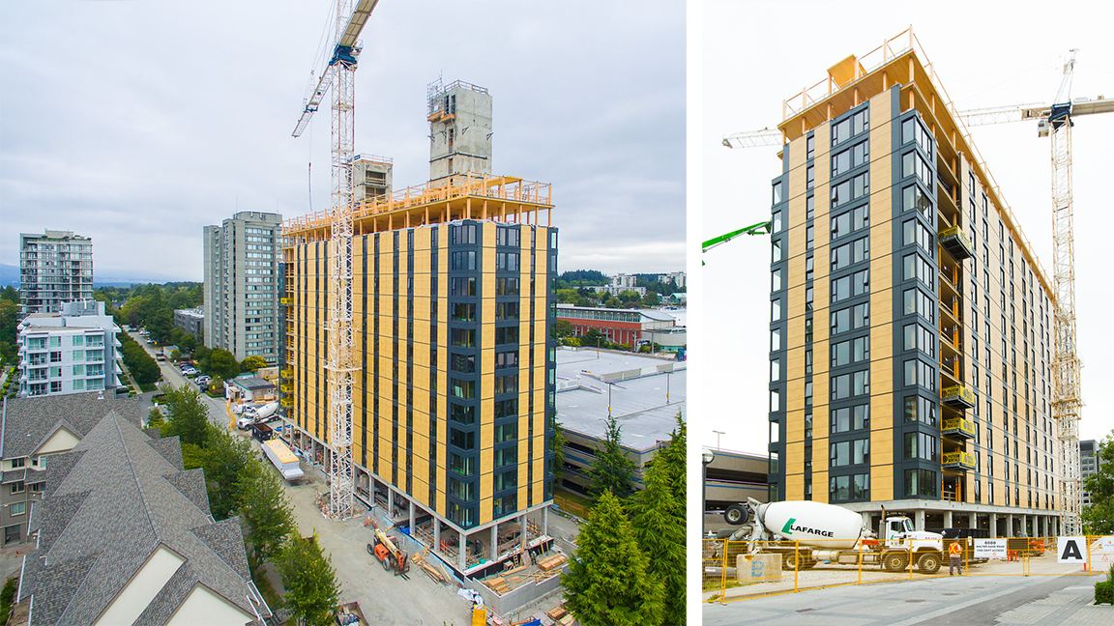
"Mass timber buildings on the rise in BC" by BC Gov Photos
is licensed under CC BY-NC-ND 2.0.
Notes:
Slide 24: In fact, the effectiveness of mass timber specifically has led to the creation of an apartment complex within Vancouver, Canada. Instead of steel and concrete, the core of this fourteen story tall building is mass timber.
Transition: These design and material principles may only be applicable if you choose to search for a similar house, or build your own, but you can also use sustainable practices where you currently live.

Slide 25
Notes:
Slide 25: Day to day sustainable utility for your home can come from several sources. First, you can install a heat pump, with the main premise of moving heat. During the summer, the heat pump takes heat from inside the house and moves it outside. During the winter, it moves heat from outside into the house. It’s a clean, cheaper way to sustain your home temperature, but you can also increase its efficiency by ensuring that your home is air tight.

Slide 26
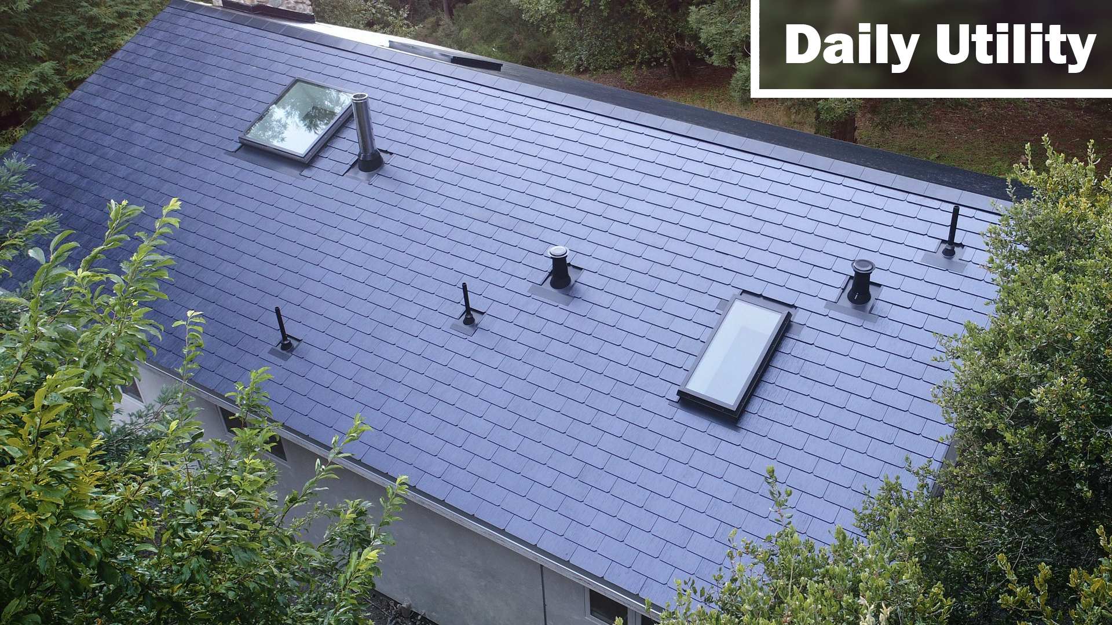
Utility (Day to Day)
Mention solar panels/shingles later on
Notes:
You can also implement ways to save energy in a directly clean way by installing a solar panel on your roof as long as reasonable. These technologies can be minimally intrusive, with my favorite example up on the screen. These are solar panel shingles, which can visually integrate into the design of your home rather comfortably.
Transition: Having discussed so many approaches to increase sustainability, I would like to highlight the frontrunner for green building certification according to the U.S Green Building Council.

Slide 27
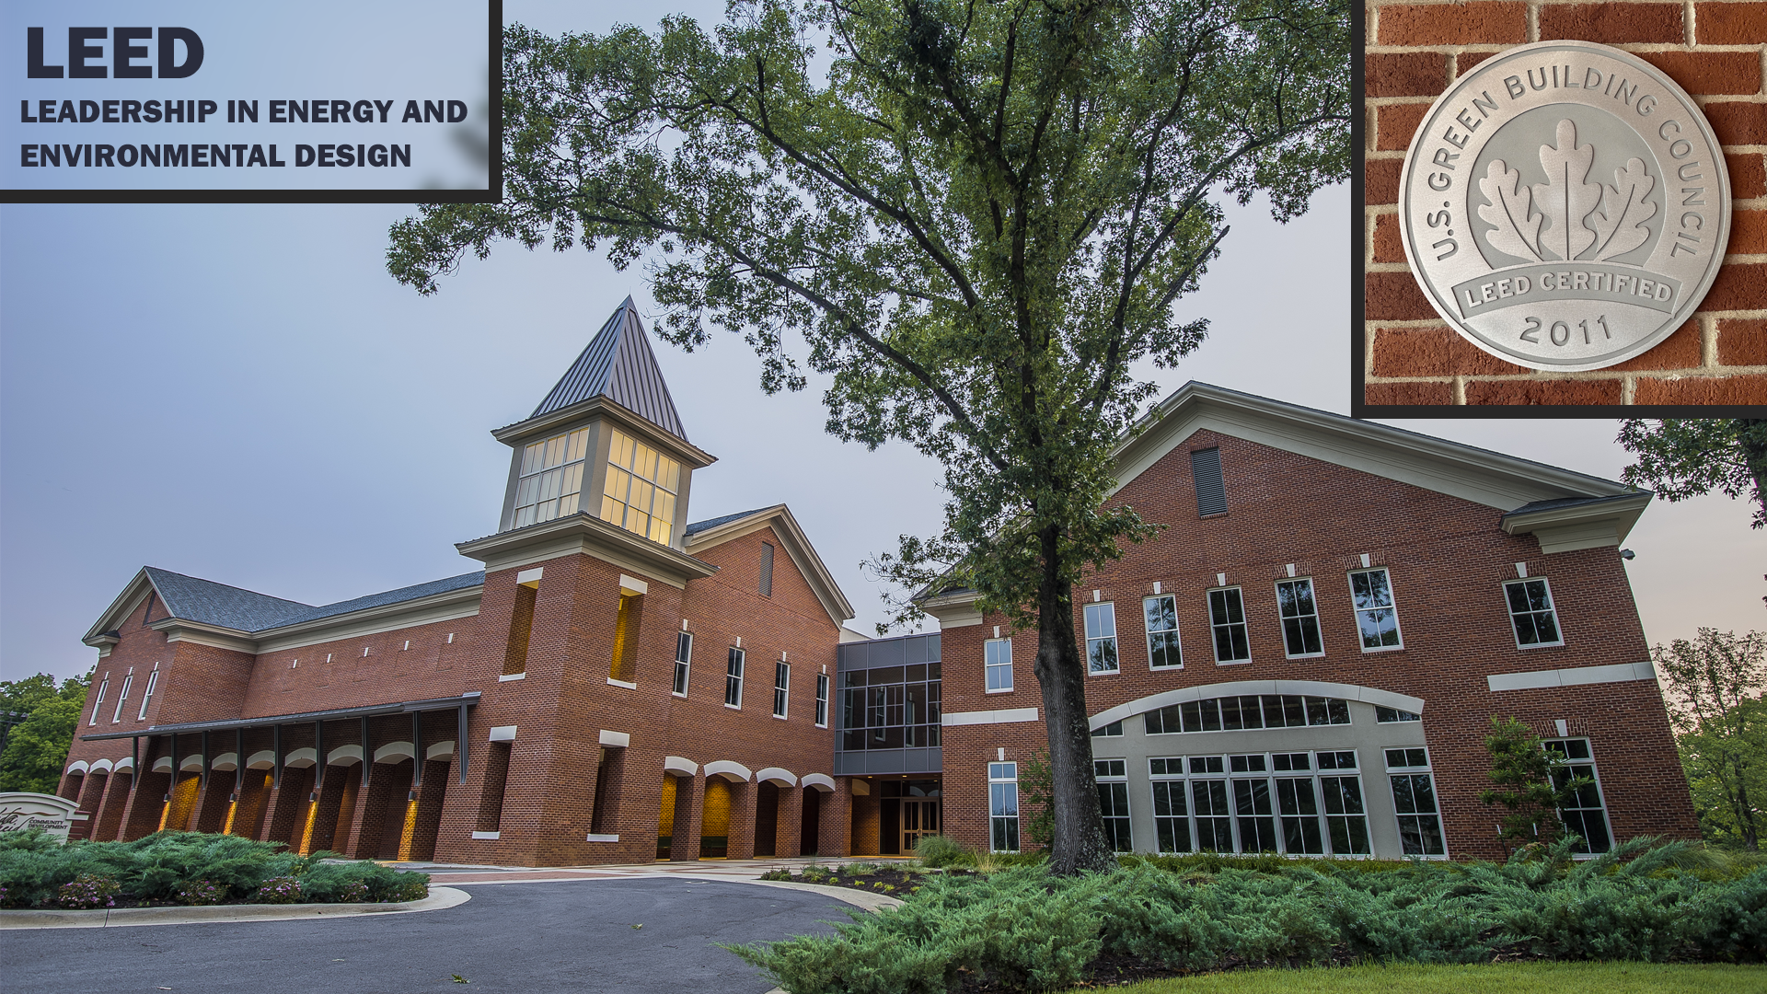
Notes:
Slide 26: The Leadership in Energy and Environmental Design certification, or LEED, stresses the creation and maintenance of healthy, highly efficient, and cost saving buildings. Its requirements span many of the solutions I’ve talked about today, but go much more in depth. For example, The Vada Sheid Community Development Center on this campus is LEED certified, and to gain that certification the college added native plants, designed the building to preserve heating, and reduced the necessity of artificial light. This lowers energy costs, which indirectly lowers carbon emissions and helps encourage native plants. The Sheid also implemented steps to improve stormwater management for our water tables. All of this culminated in an original expectation of 16% less maintenance and utility costs compared to a traditional design. While it may be difficult to get a LEED certification, it is never bad to use its requirements as a guide for your literal and metaphorical backyard.

Slide 28
Notes:
Slide 27: Before the Q&A, I’d like to reiterate that there is a way for everyone to contribute to these multifaceted problems. While you may choose to contact local representatives, or implement some practices in your daily lives, there’s a way for everyone to contribute to a brighter, greener world. Some ideas of what to suggest to politicians could be funding for sidewalks, or implementation of native plants in downtown areas. If you wish to learn more about this topic, I’ve included a document attached to this QR code with the resources I used to study this topic and ways to communicate with local and state politicians. (Show the extra information page.) If you have any questions, I’m open to answering a few.

Slide 29
Notes:
Slide 28: Important links.

