Slide 1
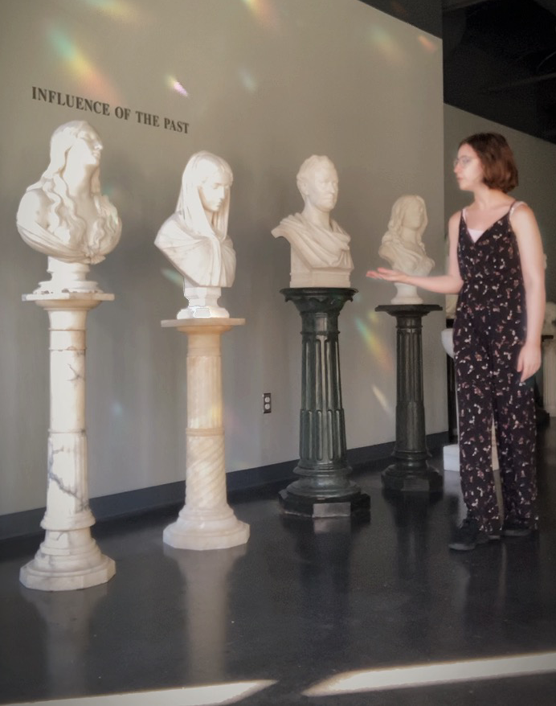
Welcome
Notes:
My name is Cassie Jankowski. I am this year’s Apex Scholar. I am a pre-nursing student interested in pursuing psychology. I often joke that I am the ghost in the Shied, because over the past two months I have spent so many hours up there, walking the halls as I do research and giving this presentation to the statue gallery. I’m hoping everyone here today will be a much more receptive audience, because the statues never want to answer my questions. They’re pretty good at listening, though.

Slide 2
Hypnagogia
From Disorder to Discovery, An Exploration of Altered Consciousness
Presented by Cassie Jankowski
2021 Apex

Slide 3
Introduction
Why conversation matters
Notes:
I want you to think about what first comes to mind when you hear the words hallucinations and altered consciousness. When we think of hallucinations, we often picture a sterotype. Someone who has taken LSD. Someone in a psychological thriller. Someone we saw for a few brief seconds as we scrolled through the news headlines. We do not often think of ourselves as we fall asleep. But what if I told you that there are hundreds of us that experience hallucinations and have no idea?
Those preconceived notions we have about hallucinations is what makes this topic so important?

Slide 4
Purpose of the Presentation
The purpose of this presentation is three-fold:
To explore the topic of hypnagogia
To decrease stigma associated with it
To better understand the mind

Slide 5
What Did I Study, and Why Is It Important?
The focus of this presentation is hypnagogia, a transitional hallucinatory state between sleep and wakefulness.
Hallucinations are heavily stigmatized in American society.
A study of hypnagogia can open new perspectives. These new perspectives would include:
Liminal (threshold) aspects of our consciousness
How we and other cultures view altered states
Utilizing altered states as inspiration and creativity
Notes:
So what did I study, and why is is understanding hypnagogia so important, other than to change our sterotypes of hallucinations?
The stigma surrounding hallucinations is important to break, because the longer hallucinations are seen as socially unacceptable to discuss, the more people are alienated or driven away from support. Last month, September, was suicide awareness month. I’m sure many of us know just how important feeling part of a community is to mental health.

Slide 6
My Experience with Hypnagogia
My first experience with hypnagogia occurred when I was five.
My hallucinations are mainly auditory.
I was afraid I would be called “weird.”
I later realized there were hundreds just like me.
Notes:
There’s one other reason why I chose hypnagogia to be my research project. Because I too experience it. For nine years I had no idea what was going on. I didn’t talk about my experiences. Not with my doctor, my parents, I didn’t even Google it. Why?
For nine years I fell asleep with my hands wrapped around my headboard bars.

Slide 7
How Hypnagogia Helps Me
It helps me retain study material.
It inspires my artwork.
If I am in a stressful period, I may hear a voice comforting me.
Notes:
My hallucinations are mainly auditordy, although they can be visual. They are also mainly harmless or meaningless, although. One example that I like to use is the night that I fell asleep to the sound of graham cracker being repeated probably a hundred times in my ears. It was as real as if someone was sitting next to me saying it. Another time was more meaningful. I was stressed, on my way to a therapy session, riding in the passenger seat. I started falling asleep, and I felt that familiar tingling sensation, that whoosh that starts at my feet and comes up through my body, over my head like a wave. I felt as though I was zooming out, entering a third-person perspective. The white noises, the clickings, whirrings, buzzings started, and then all of a sudden a voice rose out of them. It was neither male nor female, but it felt like pure peace and wisdom. It said with complete authority: And when the world ends, love will remain. I’m still not entirely sure of that significance, but I am grateful, because in a way my own mind and beliefs were trying to protect me, comfort me.

Slide 8
Defining Hypnagogia
How to think about altered states
Notes:
So, now that you’ve been introduced to the topic, I want us to learn a bit more about what they really mean. If altered states aren’t just what happens when we take psychedelics, what are they?

Slide 9
“You are in bed, your eyes are closed, you feel yourself drifting to sleep. You are drowsily aware of bright clouds drifting past, which condense into floating luminous ribbons, stars, saw-toothed lines, and geometrical forms.”
Peter Schwenger, 2008
Notes:
I want you to close your eyes as I read this quote by researcher Schwenger.

Slide 10
What Is Hypnagogia?
Have you ever...
Heard voices as you fell asleep?
Felt paralyzed as you woke?
Experienced incredibly vivid hallucinations while waking or falling asleep?
Notes:
Experiences so vivid that they seem indistinguishable from reality. And then you open your eyes, and you are lying in bed. Or maybe all of this sounds wildly new to you, and you can’t even remember what your dreams were about or if you dream. That’s ok too.

Slide 11
What Are Altered States of Consciousness?
An altered state of consciousness is defined by the American Psychological Association as “a state of psychological functioning...characterized by altered levels of...orientation to time and place, wakefulness....”
Altered states of consciousness include
Hypnagogia and hypnopompia
Hypnosis, deep meditation, sleep, and dreams
Drug or disease-related hallucinations
Notes:
In real terms, altered states of consciousness are states in which our perception is. . .well, altered. We are not at our normal levels of wakefulness.

Slide 12
Notes:
This diagram helps illustrate the concepts of hypnagogia and hypnopompia. As you’ll notice, hypnagogia and hypnopompia are marked on arrows leading towards and away from the states of being awake and being asleep. Hypnagogia and hyponpompia are marks on these arrows, almost little pockets on the continumn of human experience. Sometimes, while the mind is transitioning between wakefulness and sleep, we fall into those niches of perception in which hallucinations occur. I also want you to consider that hypnogogia and hypnopmpia are located at the same place on the arrows, except that hypnopompia occurs while one is waking up, and hypnagogia occurs while one is falling asleep. If you’re in psychology class and trying to remember this, here’s a tip for you: with hypnogogia, you are GOING to bed, G, and with hypnopompia, you are POPPING Out of bed. If that helps. There are other, smaller, distinctions between these two states, but they aren’t relevant to our topic today.

Slide 13
Viewing Consciousness Through a Different Lens: From Disorder to Discovery
We will be viewing altered states of consciousness through two models.
One is a model of disorder, which considers
Medical definitions
Associated disorders
When these states become harmful
Notes:
A relavent distinction is the two lenses that we will be using to examine hypnagogia.

Slide 14
Viewing Consciousness Through a Different Lens: From Disorder to Discovery
The other model, a model of discovery rather than disorder, allows us to explore
Cultural meanings of altered states
Creative and inspirational uses
Religious or spiritual importance
Notes:
Both models are integral, intertwined, and important to fully understanding Hypnagogia.

Slide 15
"Illumination"
Notes:
This piece of artwork is one I titled Illumination. It is my representation of what I see when I experience visual hypnagogia.

Slide 16
Lens of Disorder
Brain waves, brain function, and associated medical conditions

Slide 17
“Neither perception nor representation, each of which is linked to things in the world, hypnagogia is [no longer] adequately accounted for as 'mental images,' from which it is distinguished by the extraordinary clarity of what is sensed as appearing before the eyes....”
Peter Schwenger, 2008
Notes:
Another quote, by Schwenger. Hypnagogia is so much more than just a mental image. It is perceived as truly real.

Slide 18
Notes:
What makes hypnagogia hypnagogia? How does someone know this state is occurring? One way is in the alteration of brain waves that occurs in this state. In Hypnagogia, one experiences a marked increase in alpha, theta, and gamma waves. Other altered states also are associated with their own unique rise in brain waves. Each type of brain wave is associated with a special use in the mind. Beta is prominent in our normal waking stage. Alpha, in our resting stage. Theta waves are prominent in that transitional period, and they are known for their hypnagogic potential. Delta waves occur most frequently in the deep sleep stage, and Gamma waves occur both in vivid dreams and periods of increased self-actualization and creativity.

Slide 19
Brain Waves and Resulting Functions
Alpha waves Relaxation and introspection
Theta waves Drowsiness, decreased activity
Gamma waves Multi-sensory and perception processing
Notes:
These three types of brain waves are involved in particular activity and use.

Slide 20
Notes:
This is a model of the brain that I created to help illustrate where some of the aspects of hallucinations are processed. As you’ll see, much of the sensory aspect of hallucinations, such as voices or white noise, are processed in the temporal lobe, in blue. Visual perceptions have the entire occipital lobe to themselves.

Slide 21
Different Types of Hallucinations
Parkinson’s
50% experience hallucinations (Fénelon & Alves, 2010).
Guillaine-Barré
60% experience hallucinations (Cochen et al., 2005).
Lewy body dementia
Up to 80% experience hallucinations (National Institute on Aging, 2021).
Notes:
To understand hypnagogia, it can be useful to view hypnagogic experiences in the context of other hallucinations. First, let’s look at hallucinations and altered states in neurodegenerative diseases. These hallucinations are caused by misfunctions in the brain, due to some sort of destruction. They are mainly visual, and depending on the part of the brain impacted, the hallucinations are slightly different. For example, those with Lewey Body oftene xhibit more tactile hallucinations, or visual hallucinations that disappear upon trying to touch a visual perception.

Slide 22
Different Types of Hallucinations
Schizophrenia or psychosis
Up to 80% experience hallucinations.
These are mainly auditory, often with delusions.
They can occur while waking, and the individuals do not know that they are experiencing them.
These can be more negative than other experiences.
(Larøi, F. et al., 2014)
Notes:
Hallucinations are much more common than one may initially believe. Another condition also confused with hypnagogic hallucinations is schizophrenia. Interestingly enough, those with schizophrenic hallucinations can still experience hypnagogia. They are not the same, while they can be similar. An important difference is that.

Slide 23
Different Types of Hallucinations
Sleep paralysis
34% of those with mental illness experience it for a lifetime.
28% of students experience it at least once.
20-50% of those with narcolepsy experience it.
A negative experience is usually accompanied by feeling paralyzed or unable to breath.
This is a form of hypnopompia.
Notes:
Lastly, lets look at sleep paralysis, a condition we will be examining more later. Sleep paralysis is actually a subset of hypnopompia characterized by the terrifying or disturbing nature of the hallucinations as well as the tactile feeling of loss of breath and paralysis.

Slide 24
How Is Hypnagogia Different from Other States?
Occurs without illness
Full-sensory
Triggered by different activities
Notes:
It is often difficult to understand the difference between hypnagogia and other altered states of consciousness. These three distinctions are integral to differentiate hypnagogia from other conditions, as well as the specific brain waves that mark the hypnagogic state.
This experience is notable for its full-sensory potential and perception of importance or urgency.

Slide 25
Who Experiences Hypnagoia?
General population: 37% (Waters et al., 2016)
Insomnia
Narcolepsy
Disrupted sleep
Adolescents
Mental Illness
(Yetman, 2020)
Notes:
Who is most prone to these hallucinations? Up to 70% of the population will experience some form of hypnogogia, from minimal to extreme.And me. I am an adolescent female, with ADHD, anxiety, insomnia, excessive daytime sleepiness, and other disrupted sleep patterns. I am a prime candidate for hypnagogia. I experience it on a nightly basis, as I have for the past twelve years.

Slide 26
Notes:
This diagram shows just how many experiences altered states truly encompasses. There is so much more to altered states than we may initially believe. There are so many more types of hallucinations as well. Through the lens of disease, we are able to contrast hypnagogia to medical conditions, and later, through the lens of discovery, we will be able to contrast hypnagogia to spiritual and creative states such as meditation and flow state.

Slide 27
Notes:
This diagram shows just how many experiences altered states truly encompasses. There is so much more to altered states than we may initially believe. There are so many more types of hallucinations as well. Through the lens of disease, we are able to contrast hypnagogia to medical conditions, and later, through the lens of discovery, we will be able to contrast hypnagogia to spiritual and creative states such as meditation and flow state.

Slide 28
Notes:
This diagram is a visual representation of the range of experiences in hypnagogia. I want to emphasize that those who experience sleep paralysis can have very negative experiences. However, for those in which hypnagogia manifests positively, these experiences can be incredibly insightful, meaningful, and joyful.

Slide 29
Hypnagogia Is a Range of Experiences
Experiences range from simple visual hallucinations to meaningful spiritual experiences.
Like dreams, the simple or neutral experiences fade quickly.
Emotionally charged experiences are often remembered for a lifetime.
Notes:
Hypnagogia also lasts for a different period of time for everyone. For some, the experience can be seconds or half an hour. It is also individual how often hypnagogia happens. For some, it may only happen once in their lifetime, while for others, it may be a nightly occurrence for years.

Slide 30
How One Might Increase the Chances of Experiencing Hypnagogia
Meditation
Breath work
Listening to guided audio for sleep
Notes:
I hope that video gave you a better understanding of what hypnagogia can really look like. If it made you curious, you may be wondering how hypnagogia happens. Can it be induced? Does it just occur by chance? The answer is a bit of both. If you want to increase your chances of experiencing hypnagogia, these three techniques can help. They do not guarantee that someone will experience hypnagogia, but they can help raise one’s chances.
Why would someone want to induce this state? It can seem so unsettling. Hypnagogia is an incredibly powerful tool in increasing creativity. Without spoiling too much of what we will be discussing shortly, I want to leave you with the thought that some of the greatest creations were born through hypnagogia. For example, the German scientist Kekule was able to discover a new model for the hydrocarbon molecule, a diagram now present in nearly every intro to chemistry college course. As he fell asleep at his fireplace, he began to see flashing lights that formed geometric shapes, giving him the inspiration for his model.

Slide 31
How One Might “Escape” Hypnagogia
Trying to move individual fingers
Breathing exercises
Falling deeper into sleep
Formulating a trigger
A trigger that is done throughout the day may help stop hypnagogia if the trigger is repeated in the altered state.
Notes:
Or maybe after seeing all that, you don’t want to experience hypnagogia. Maybe all of that looks terrifying to you. Maybe you have had hypnagogia and you never want to experience it again. How might you stop hypnagogia while you are in it?

Slide 32
Is Hypnagogia Harmful?
Hypnagogia is not in itself harmful.
However, if the following conditions exist, please seek a healthcare provider’s counsel.
If it interferes with your day-to-day life
If it is tied to underlying health conditions, such as insomnia, Alzheimer’s, or depression
Notes:
Knowing all that, I want to pose a question to you. Is hypnagogia harmful? In itself, no. It is true that hypnagogia is associated with mental and sleep disorders. However, I want to impress on you that hypnagogia is not a symptom of illness. It does not cause illness. One can be perfectly healthy and experience hypnagogia, just like one can be perfectly healthy and experience dreams. Even if one does have hypnagogia and an associated illness, hypnagogia is not what causes harm. I frequently compare hypnagogia to dreams because dreams are such a normalized part of the human experience, unlike hypnagogia, and dreams are not harmful, just like hypnagogia. I want us to be able to view hallucinations and hypnagogia in the same view that we do dreaming.
What causes this difference? Why are some experiences negative and some experiences positive? It is still unknown. Hypnagogia manifests differently in every individual. What makes hypnagogia less harmful is the fact that it does not harm the brain or often interfere with day-to-day life, unlike illnesses and disorders. Culture has also had an enormous impact on what is seen as harmful.

Slide 33
"Reflection"
Notes:
This piece is titled reflection. In this, I hope to capture the ethereal feeling of hypnagogia. I hope to capture the double antrue of the experience, how it can manifest in a positive way and a negative way. I hope to capture the duality of it and the way it makes me view myself differently after I come out of an experience.

Slide 34
Lens of Discovery
Creativity in altered states, religious/spiritual meaning, revelation, and cultural differences
Notes:
Let’s move on to the lens of discovery.

Slide 35
“...where the confines of the waking world blend with those of the world of dreams.”
Edgar Allen Poe, 1846
Notes:
Another quote, this time by Edgar Allen Poe.

Slide 36
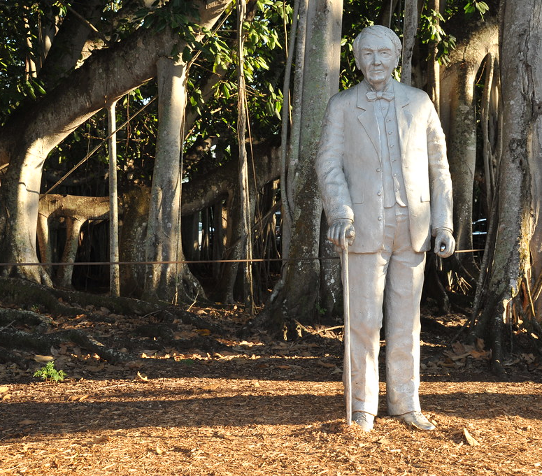
Hypnagogia and Creativity
Edison was known to take naps with steel balls in his hands. As he entered hypnagogia, he would unconsciously drop the balls and come to wakefulness (Charles, 2010).
This Photo by Unknown Author is licensed under CC BY
Notes:
Several famous figures have used hypnagogia in their creative innovations.
Edison was well-known for his strange sleep schedule. However, he stayed in hypnagogia long enough to discover novel solutions.
As Kekule fell asleep at his fireplace, he saw colored lights form before his eyes, much like the ones I depicted in my first piece of artwork. This shape formed gave hi inspiration on the model.

Slide 37
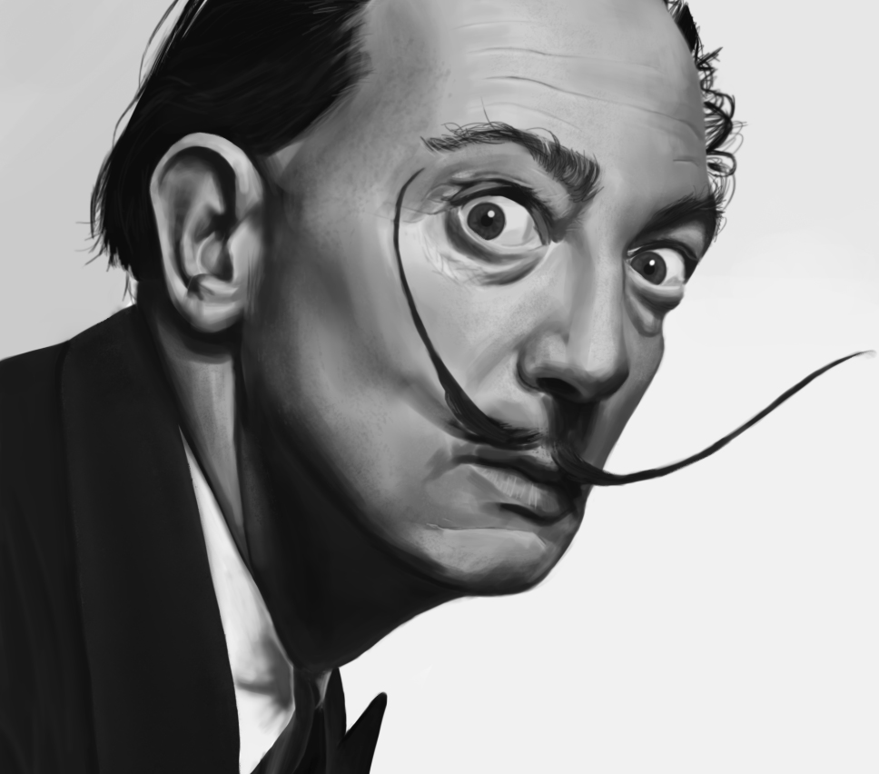
Hypnagogia and Creativity
Dali used hypnagogia to solve creative problems and brainstorm his paintings (Courier Corporation, 1992).
This Photo by Unknown Author is licensed under CC BY-SA
Notes:
Salvador Dali was very open about using the inbetween state between sleep and wakefulness

Slide 38
Hypnagogia and Creativity
A study showed that, for individuals with narcolepsy, hypnagogia increased creativity (D’Anselmo, et al. 2020).
It is not fully understood how hypnagogia can generate novel ideas.
Solutions to complex problems often seem to arise while one is experiencing hypnogogia.
Notes:
Why hypnagogia can have this amazing ability to generate novel ideas is not fully understood. However, we do know that solutions to complex problems do often seem to arise in hypnagogia. In fact, a study by D’Anselmo and colleagues showed that for individuals with narcolepsy, hypnagogia was able to significantly increase their creative thought.

Slide 39
Hypnagogia and Spirituality
Those experiencing hypnagogia often indicate a connection to a higher consciousness.
This seems to occur in a specific period of brain activity in hypnagogia, different from the activity that occurs during passive or simple hallucinations.
(D'Anselmo, A. et al., 2020)
Notes:
How does spirituality tie into all of this? For a condition that seems so based in neurobiology and the disturbance of the sleep cycle, why does religion and belief have an important role?
Because hypnagogia itself seems to carry an intrinsic aspect of connection. Across dozens of cultures, those experiencing hypnagogia indicate that in that state, they have some experience connecting them to a higher consciousness, whether good or evil. Hypnagogia can be meaningless, but this meaningful undertone

Slide 40
Altered States and the Imaginal Realm
The imaginal realm is the confluence between different states of consciousness.
Differs with every culture and religion
Known as a liminal space between physical and spiritual, visible and invisible
Place of increased collective perception and creativity
Many altered states seem to lead into or carry aspects of the imaginal realm.
Notes:
What is the imaginal realm? It’s exact definition or reference differs.
You may say that this is only a perception, hypnagogia only makes us perceive that we are connected to a higher power. And that’s okay. Maybe you belive that the spiritual meaning in hypnagogia is only our brain longing for some deeper meaning. That isn’t for me to say for you. However, with the research, one cannot deny that hypnagogia at the very least leads one to often feel spiritualy connected. How that is interpreted depends vastly on the culture.

Slide 41
Different Types of Altered States
Meditation
Visions
Peak experience
Lucid dreams
Notes:
These states are often those associated with the imaginal realm. They are also often compared to hypnagogia, and while all of these states also can increase creativity, they are different from hypnagogia, just as hallucinatory states in dementia are different from hypnagogic hallucinations. For instance, meditation, visions, and peak experience all occur while one is awake. Meditation and peak experience are often induced.

Slide 42
How is Hypnagogia Different?
Occurs while asleep
Different brain wave activity
Altered level of perception
Notes:
Hypnagogia is different from these states in similar ways that it is different from diseases. It occurs at a different time, has markedly different brain waves, and presents different hallucinations.

Slide 43
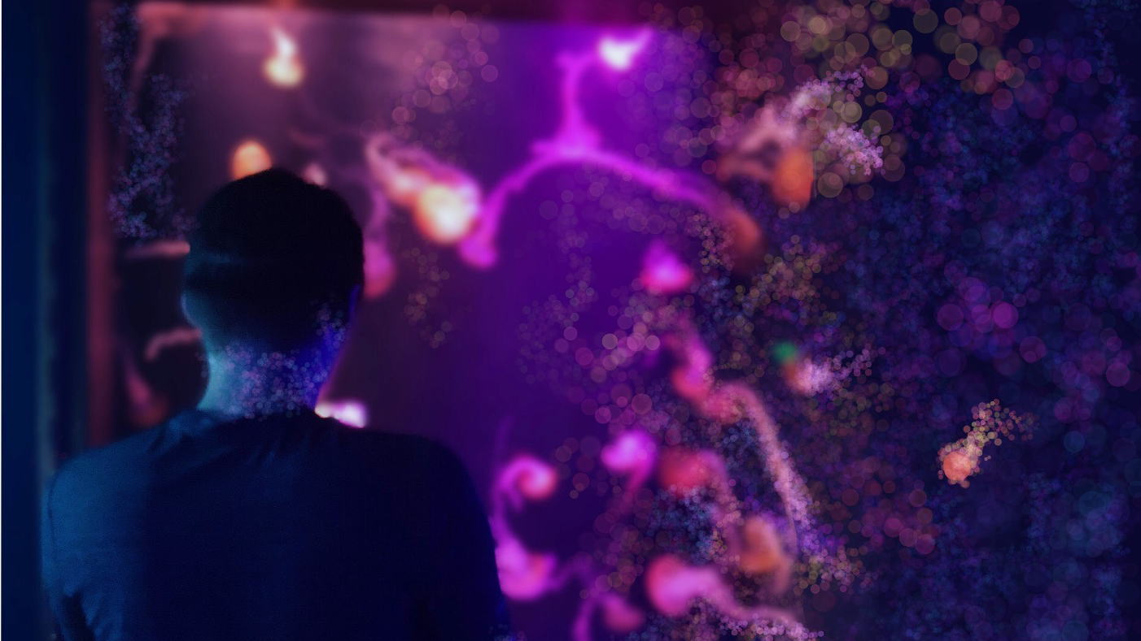
"Incandescent"
Notes:
This piece is titled incandescent. It is a representation of my partner and what he would appear to me as in the altered state. The jellyfish around him seem to grow and sissolve into the waters.

Slide 44
Hypnagogia and Culture
Cultures such as many of those found in the United States often see hallucinations as a violation of the mind, while other cultures see hallucinations as connections with spirits or loved ones (Luhrmann et al., 2015).
Notes:
Let’s go back to culture. Not all cultures are as dismissive of hallucinations and those who experience them as the American culture.
I want you to think about why the American culture vies hallucinations in this way. It is true that some sub-cultures of American society view hypnagogia or hallucinations in a positive light. There are writings from Mormon scholars going back to the 1800s and their accounts of hypnagogia, a seemingly meaningful and important experience. But why do we generally view it so negatively now? That’s not a question I can answer for you. I want you to think about your own biases for a moment. Is it because we are afraid? Is it because we fear being wrong, different, losing control of our own mind?

Slide 45
Hypnagogia and Culture
Different cultures often have similar explanations of hallucinations
Demonic or angelic figures
Wise, loving, eternal presence
Symbols of death or healing
Notes:
Again, across cultures, these elments seem to arise. These symbols are not necessarily the same, but their meaning usually is.

Slide 46
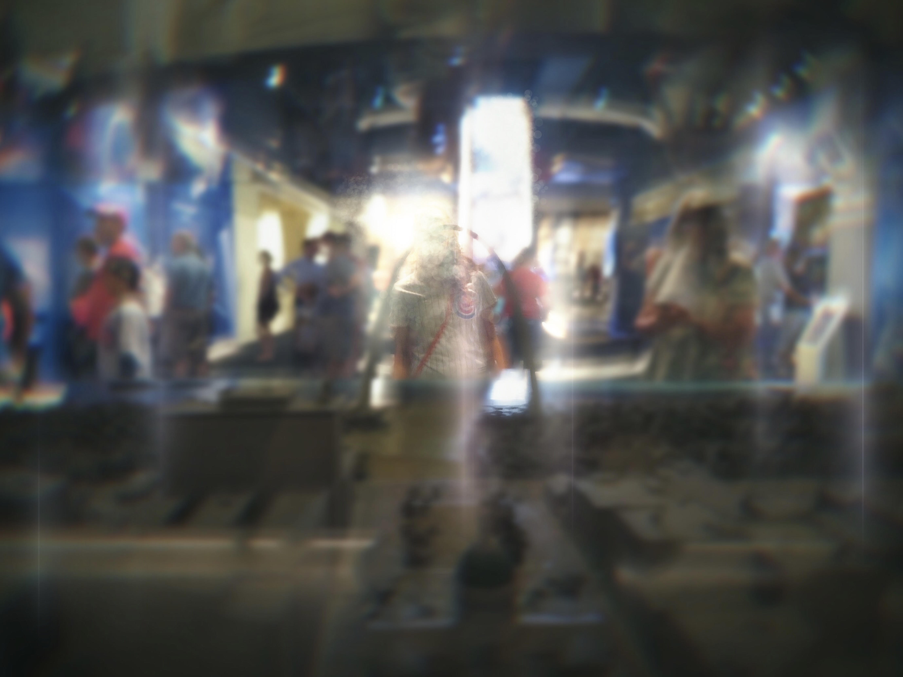
"Prismatic"
Notes:
This piece is titled prism. I want you to consider why we treat hypnagogia so differently across cultures.

Slide 47
Conclusion
Expectations, findings, and Q&A

Slide 48
“I had a dream that the sky was falling, purple bursting through the clouds / Sun exploding on the horizon, golden stars raining down. . .”
Cassie Jankowski, 2019

Slide 49
What Did I Expect to Find and Why Did I Expect to Find those Results?
I expected to discover that
There are many more people who experience hypnagogia than are reported due to the social stigma surrounding discussions of altered states.
There is a lack of conversation around hypnagogia because of this social stigma.

Slide 50
What Did I Expect to Find and Why Did I Expect to Find those Results?
There is a link between
Altered states of consciousness and increased levels of creativity or spiritual connection due to religious practices
Those with other sleep or mental disorders experiencing hypnagogia because of hypnagogia’s tie to sleep and hallucinations

Slide 51
What Did I Discover?
Hypnagogia is experienced by many that I interviewed.
Hypnagogia has been an artistic muse, study technique, and tool for me to solve problems.
Hypnagogia has many resources dedicated to it, but they are buried and often hard to access.

Slide 52
What Did I Discover through the Literature?
Many people are afraid to speak about their experiences and mental health (APA, 2020).
Hypnagogia is linked to other conditions such as insomnia, sleep deprivation, and mental illnesses (Ohayon, 1996).
Hypnagogia is incredibly complex, containing layers of brain activity that change the nature of the hallucinations, their persistence in memory, and their perceived meaning.

Slide 53
What Did I Discover through the Literature?
Hypnagogia was used by many famous figures for creativity.
Hypnagogia shares many neurological aspects with other forms of hallucinations.
Hypnagogia is unique from other hallucinations by when it occurs, how it is processed in the mind, and the type of hallucinations that occur.

Slide 54
Why Are These Discoveries Meaningful?
Individuals should not have to live in silence or be shamed because of their or experiences.
Understanding this experience and having a conversation helps us
Raise awareness
Appreciate multiple cultures views of altered states
Use our minds to their fullest potential
Notes:
The more we learn, the less afraid we will be.

Slide 55
What Is Next?
More research needs to be done.
How is hypnagogia caused?
How does hypnagogia occur in the brain?
How are hallucinations connected to disorders such as insomnia and depression?

Slide 56
What Is Next?
More research needs to be done.
How can altered states be used to harness healing from trauma?
How can hypnagogia increase creative thought?
How can hallucinations influence spiritual connection?
Notes:
There is still not a clear consensus on many aspects of hypnagogia. I had a lot of conflicting reports to sort through to find the majority of what experiences looked like. There needs to be a clearer consensus on what hypnagogia truly is and how it is defined.

Slide 57
What Is Next?
My hope is that hypnagogia will be viewed as another valuable human experience that has the potential to increase creative thought and healing from trauma.
I am dedicated to continuing to talk about this, and it is my hope that you will join me.
Notes:
I want to leave you with this thought. Who in your life feels alienated? Who in your life experiences illness? Whether soeone experienced hypnagogia or not. Who can you better understand and show curiosity towards? Maybe its your partner or best firned. Maybe it’s yourself. Maybe its your family. How can we better show support? How can we better appreciate the crazy and awesome capability of our own minds?

Slide 58
Conclusion and Q&A
I would like to open the floor to any questions you may have.
I also ask that when we are done meeting today, you would fill out our survey about hypnagogia.

Slide 59
References

Slide 60
References
American Psychological Association. (2020). Altered state of consciousness. In APA Dictionary of Psychology. Retrieved September 3, 2021, from https://dictionary.apa.org/altered-state-of-consciousness
Charles, D. (2010). Hypnagogia: How to dream like Thomas Edison. https://davidcharles.info/how-to-be-human/hypnagogia-how-to-dream-like-thomas-html/
Cochen, V., Arnulf, I., Demeret, S., Neulat, M. L., Gourlet, V., Drouot, X., Moutereau, S., Derenne, J. P., Similowski, T., Willer, J. C., Pierrot-Deseiligny, C., & Bolgert, F. (2005, November). Vivid dreams, hallucinations, psychosis and REM sleep in Guillain-Barré syndrome. Brain, 128(11), 2535–2545. https://doi.org/10.1093/brain/awh585
Dali, S. (1992). 50 Secrets of magic craftsmanship. Courier Corporation.
D'Anselmo, A., Agnoli, S., Filardi, M., Pizza, F., Mastria, S., Corazza, G. E., & Plazzi, G. (2020). Creativity in narcolepsy type 1: The role of dissociated REM sleep manifestations. Nature and Science of Sleep, 12, 1191–1200. https://doi.org/10.2147/nss.s277647

Slide 61
References
Fénelon G, Alves G. (2010, February 15). Epidemiology of psychosis in Parkinson's disease. Journal of the Neurological Sciences, 289(1-2):12-7. doi: 10.1016/j.jns.2009.08.014. Epub 2009 Sep 8. PMID: 19740486.
HandintheBoxInc. (2019, May 30). Hypnagogic hallucinations simulation. [Video.] YouTube. https://www.youtube.com/watch?app=desktop&v=NfPNefYvkwk&t
Larøi, F., Luhrmann, T. M., Bell, V., Christian, W. A., Jr, Deshpande, S., Fernyhough, C., Jenkins, J., & Woods, A. (2014). Culture and hallucinations: Overview and future directions. Schizophrenia Bulletin, 40(Suppl 4), S213–S220. https://doi.org/10.1093/schbul/sbu012
Luhrmann, T., Padmavati, R., Tharoor, H., & Osei, A. (2015). Differences in voice-hearing experiences of people with psychosis in the USA, India and Ghana: Interview-based study. British Journal of Psychiatry, 206(1), 41-44. doi:10.1192/bjp.bp.113.139048
National Institute on Aging. (2021). What is Lewy body dementia? Causes, symptoms, and treatment. https://www.nia.nih.gov/health/what-lewy-body-dementia-causes-symptoms-and-treatments

Slide 62
References
Netzer, D. (2015). Introduction to the special topic section on arts and consciousness. International Journal of Transpersonal Studies, 34(1-2), 65–69. http://dx.doi.org/10.24972/ ijts.2015.34.1-2.65
Ohayon, M. M., Priest, R. G., Caulet, M., & Guilleminault, C. (1996). Hypnagogic and hypnopompic hallucinations: Pathological phenomena? The British Journal of Psychiatry: The Journal of Mental Science, 169(4), 459–467. https://doi.org/10.1192/bjp.169.4.459
Poe, E. A. (1846). Marginalia 150. Graham’s American Monthly Magazine of Literature and Art, 28(2), 116-118. https://www.eapoe.org/works/pollin/brp20405.htm#m150
Rice, S. (2021, May 28). Hypnagogic hallucinations. ArcGIS StoryMaps. https://storymaps.arcgis.com/stories/bfe1d87554f44a9fbbbfaa98507c8971
Schwenger, P. (2008). Writing hypnagogia. Critical Inquiry, 34(38), 423-426. https://www.academia.edu/20409678/Writing_Hypnagogia

Slide 63
References
Waters, F., Blom, J. D., Dang-Vu, T. T., Cheyne, A. J., Alderson-Day, B., Woodruff, P., & Collerton, D. (2016). What is the link between hallucinations, dreams, and hypnagogic–hypnopompic experiences? Schizophrenia Bulletin, 42(5), 1098–1109. https://doi.org/10.1093/schbul/sbw076
Yetman, D. (2020, October 26). Hypnagogia: How the state between wakefulness and sleep works. Healthline. https://www.healthline.com/health/hypnagogia#effects

Slide 64
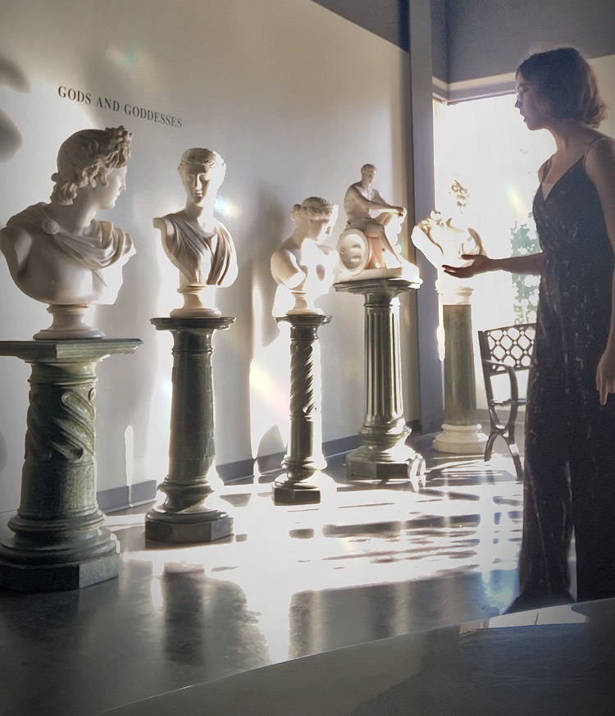
Thank You!
Notes:
I want you to think about what first comes to mind when you hear the words hallucinations and altered consciousness. When we think of hallucinations, we often picture a sterotype. Someone who has taken LSD. Someone in a psychological thriller. Someone we saw for a few brief seconds as we scrolled through the news headlines. We do not often think of ourselves as we fall asleep. But what if I told you that there are hundreds of us that experience hallucinations and have no idea?
Those preconceived notions we have about hallucinations is what makes this topic so important?

