Slide 1
Scientifically Literate: the world, the community, the individual

Slide 2
What did I study and why is it important?

Slide 3
“Scientific illiteracy is the lack knowledge and understanding of scientific concepts and processes required for personal decision making, participation in civic and cultural affairs, and economic productivity.”

Slide 4
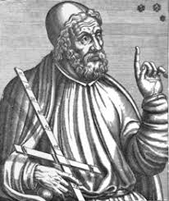
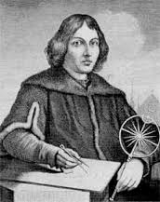
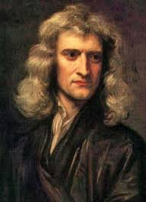
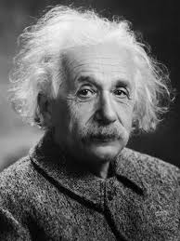
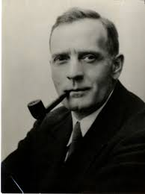
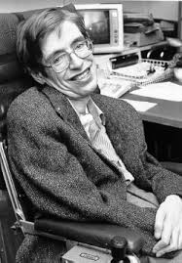
Ptolemy
Copernicus
Kepler
Newton
Einstein
Hubble
Sagan
Hawking
AD 100 – AD170
1473-
1543
1571-
1630
1879-
1955
1889-
1953
1934-
1996
1942-
1642-
1726

Slide 5
“Too Many Know Too Little”
53% of Americans believe that the earliest humans lived at the same time as dinosaurs
59% of Americans believe that the complexity of life cannot have risen out of random or chance events
52% of Americans believe that lasers work by focusing sound waves
46% of Americans did not know that electrons are smaller than atoms
67% of Americans believe that the statement “Human beings, as we know them today, developed from earlier species of animals” was false.
Americans’ Scientific Knowledge and Beliefs about Human Evolution in the Year of Darwin | NCSE. (n.d.). Retrieved from https://ncse.com/library-resource/americans-scientific-knowledge-beliefs-human-evolution-year

Slide 6
What did I expect to find and why did I expect to find it?

Slide 7
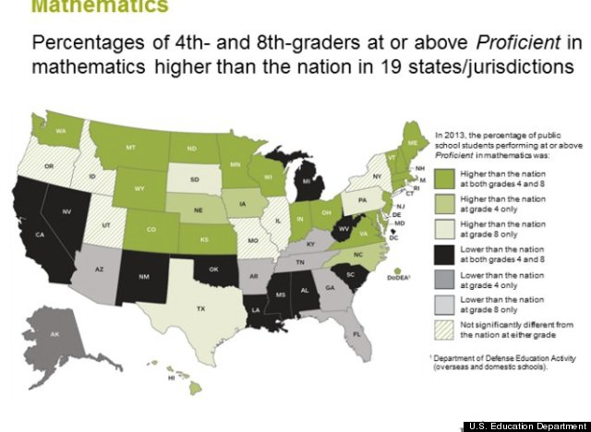
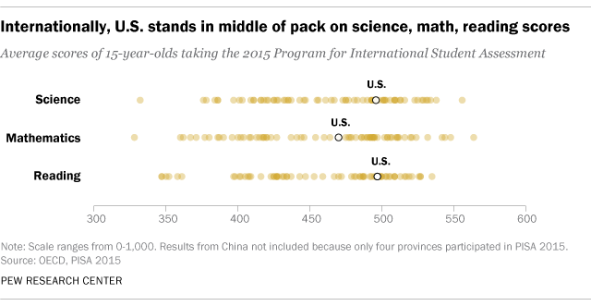
education of STEM
U.S. academic achievement lags that of many other countries | Pew Research Center. (n.d.). Retrieved from http://www.pewresearch.org/fact-tank/2017/02/15/u-s-students-internationally-math-science/
National Test Scores Show Slight Math, Reading Increases For American Students | HuffPost. (n.d.). Retrieved from http://www.huffingtonpost.com/2013/11/07/national-test-scores_n_4229264.html

Slide 8
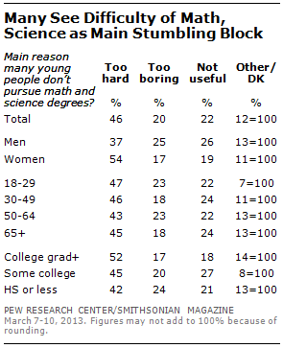
Why don’t young people go into STEM fields?
22% said STEM was not useful to their careers
20% STEM subjects are “too boring”
46% STEM subjects are “too hard”
Public’s Knowledge of Science and Technology | Pew Research Center. (2013, April 22). Retrieved from http://www.people-press.org/2013/04/22/publics-knowledge-of-science-and-technology/

Slide 9
Where do they go?
Top ten most popular majors in the u.S
#1 Business & Management
#2 nursing
#3 Liberal arts & General Studies
#4 General Psychology
#5 General Biology
#6 Criminal justice
#7 accounting
#8 teacher education
#9 communications
#10 English/literature
Tezlaff, R. (2016, December 1). Top 10 Most Popular Majors in the U.S. — Inside College Factual. Retrieved from http://inside.collegefactual.com/stories/top-10-most-popular-majors

Slide 10
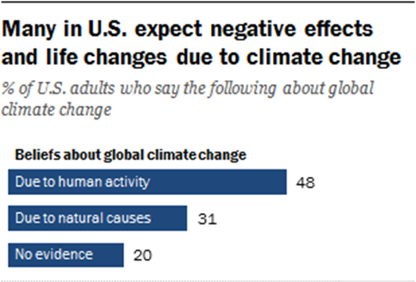
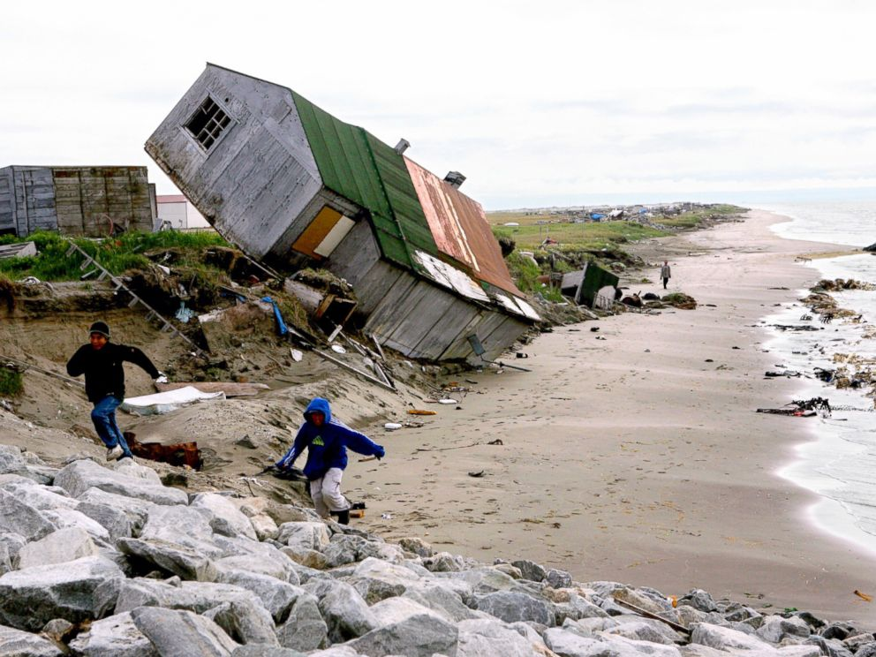
A scientific controversy
A home destroyed by beach erosion tips over in the Alaskan village of Shishmaref, Sept. 27, 2006.
Leaving Their Ancestral Home: Alaska Village Votes to Move Due to Climate Change - ABC News. (n.d.). Retrieved from http://abcnews.go.com/US/leaving-ancestral-home-alaska-village-votes-move-due/story?id=41482755

Slide 11
Why deny?
Families from across the U.S. living with autism take part in a rally calling to eliminate toxins from children’s vaccines in Washington June 4, 2008. Various U.S. government agencies and non-government health experts agree there is no evidence that can link autism to any kind of vaccine, but a small and highly vocal group of activists remain unconvinced.

Slide 12
What did I discover instead and why is that discovery meaningful?

Slide 13
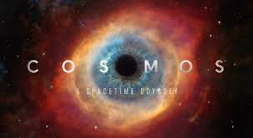
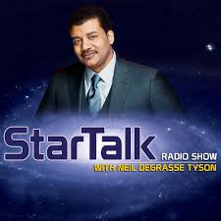
“The truth IS out there”

Slide 14
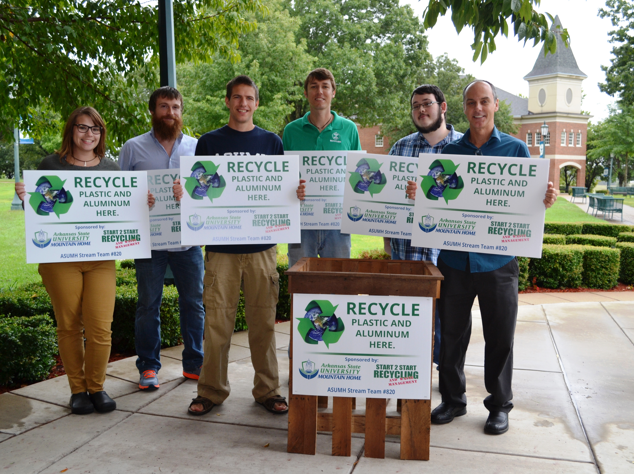
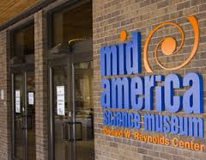
Be active
ASUMH Stream Team

Slide 15
References
http://www.livescience.com/57590-why-americans-deny-science.html
http://www.huffingtonpost.com/entry/why-americans-deny-evolution-climate-and-vaccine-science_us_5888cd7ce4b098c0bba7db84
http://www.pewresearch.org/fact-tank/2017/02/15/u-s-students-internationally-math-science/
http://www.smithsonianmag.com/innovation/how-much-do-americans-know-about-science-27747364/
https://www.theatlantic.com/health/archive/2015/01/americans-believe-in-science-just-not-its-findings/384937/
https://19january2017snapshot.epa.gov/sites/production/files/2016-08/documents/print_temperature-2016.pdf
https://climate.nasa.gov/effects/
https://ncse.com/library-resource/americans-scientific-knowledge-beliefs-human-evolution-year
Tyson, N. D., Lang, A., Willis, & Mirron. (2015). Space chronicles: Facing the ultimate frontier. Grand Haven, MI: Brilliance Audio.

