Slide 2
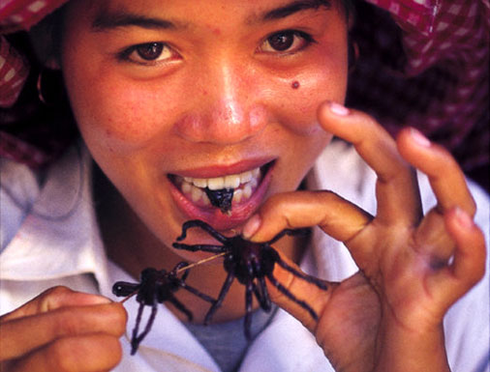

Slide 8
OUTLINE
Feral Children Background
Genie / Two Movies / Two Books / Two Authors
Genie’s Family Background
Genie’s Isolation
Genie’s Post Isolation Discovery & Treatment
Critical Period Hypothesis
Rh Blood Factor & Rh Blood Poisoning
“S” Supposition
Conclude and Questions

Slide 10
VICTOR of AVEYRON - 1799

Slide 12
GENIE

Slide 16
Clark Wiley

Slide 17
Dorothy Irene Wiley

Slide 18
The Wiley Children
#1 – Dorothy Irene Wiley – Born – 06/02/1948 Died – 08/19/1948
#2 – Robert Clark Wiley – Born – 09/15/1949 Died – 09/17/1949
#3 – John Gray Wiley – Born – 03/11/1952
Died – 02/18/2011
#4 – Susan M. Wiley (aka – GENIE)
Born – 04/18/1957

Slide 27
Critical Period Hypothesis: States that the first few years of life are a crucial time to first-language acquisition if presented with adequate stimuli.

Slide 31
Rh Blood Poisoning:
When the mother’s blood is not compatible with the blood of the fetus.
Side Effects:
Poor Brain Development
Cognitive & Learning Disabilities
Epilepsy
Spina Bifida
Cerebral Palsy
Still Birth

Slide 32
“S” SUPPOSITION: Was Genie a good scientific subject to test the Critical Period Hypothesis?

